Slide 1




Social Water Science Data in iUTAH: Dimensions, Data Management, and Visualization
Amber Spackman Jones Jeffery S. Horsburgh, Courtney G. Flint, Douglas Jackson-Smith
This project is funded by National Science Foundation grants 1208732. Any opinions, findings, and conclusions or recommendations expressed in this material are those of the author(s) and do not necessarily reflect the views of the National Science Foundation.

Slide 2
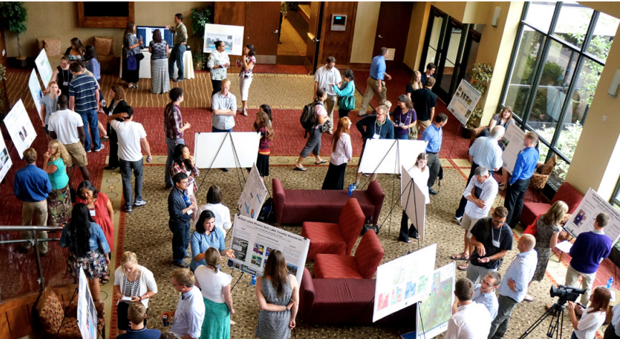
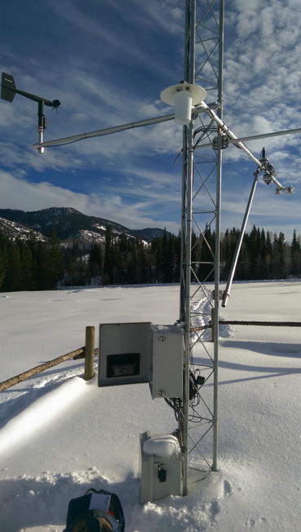
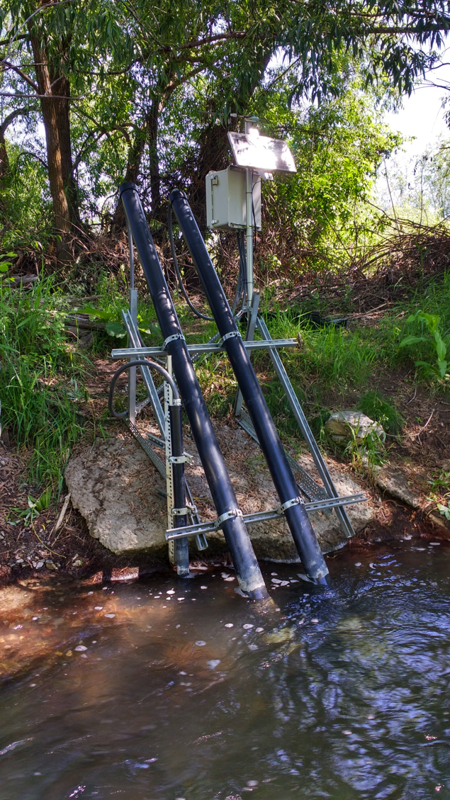
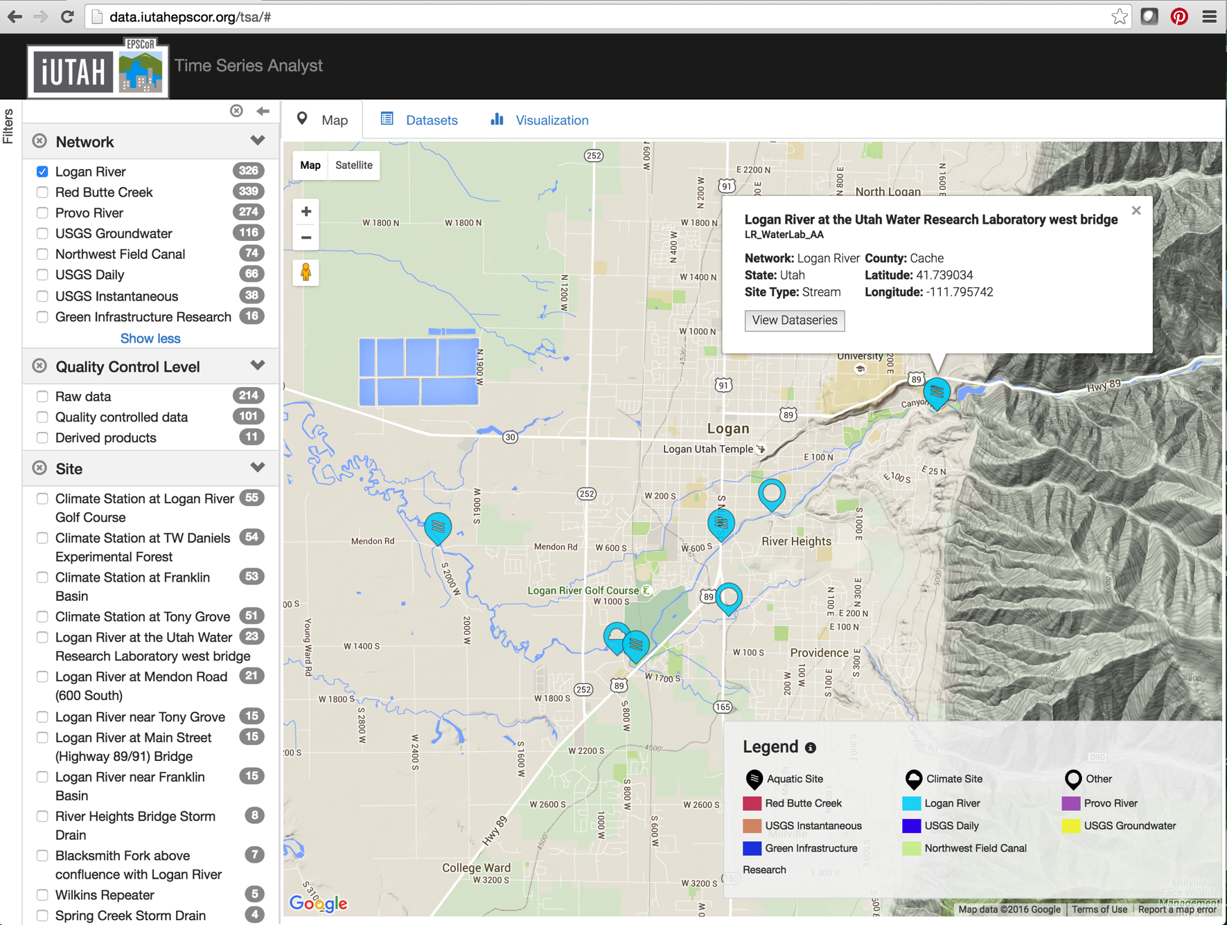
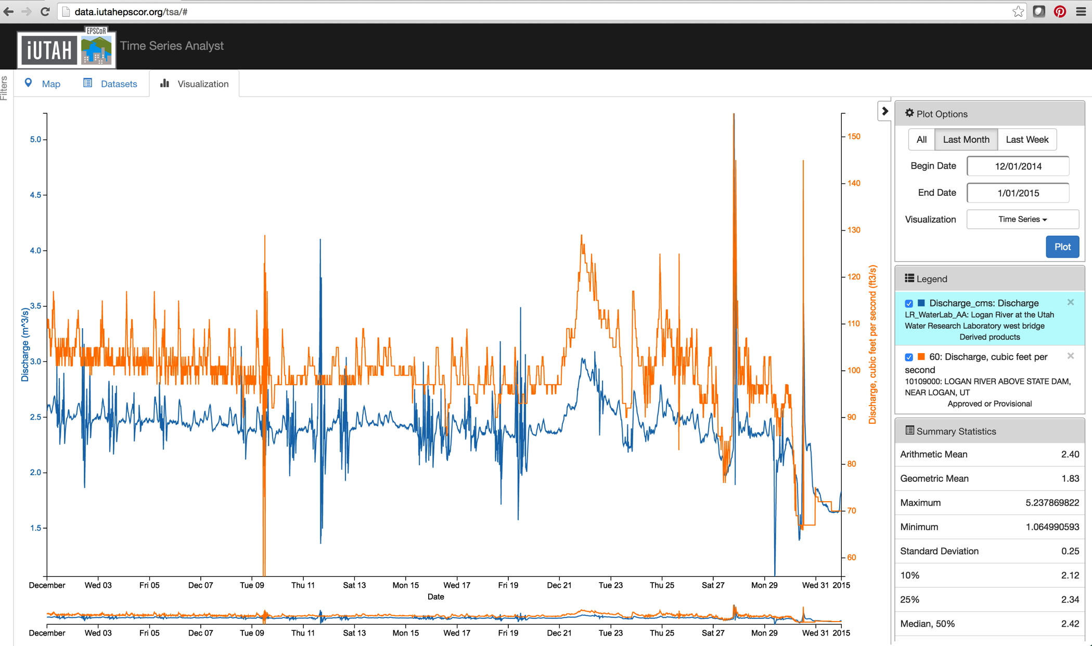
iUTAH: innovative Urban Transitions and Aridregion HydroSustainability
Water systems are increasingly conceptualized as coupled human-natural systems.
iUTAH: Seeks to integrate and share social and biophysical water data
Developed cyberinfrastructure (CI) for baseline biophysical data
Sought analogous CI for social science data
Notes:
iUTAH: aims to capture and integrate information about the human and natural aspects of water resources within the state of Utah
I’m not a social scientist, I’m an engineer and a data manager, so I’m concerned about how we handle, support, and integrate data collected as part this socio-hydrologic project.
We started working with social scientists and data types that we as data management team thought that we could better support and better provide access to.
Needed to raise the bar of understanding for social scientists and hydrologists working together to understand the types of data and the implications for data access, visualization and management.
iUTAH has faced and addressed data sharing and publication challenges across biophysical and social sciences.

Slide 3
Social Water Science Data
Information representing human aspects of a water system
PRIMARY
RESTRICTED
HUMAN SUBJECTS
PRIMARY/SECONDARY
Primary data are newly collected.
Secondary are obtained from another source.
Data controlled by another entity.
Data subject to licensing, copyright, use agreements limiting distribution.
Data from or about people.
Collection and management requires approval from independent ethics review.
UNRESTRICTED
NOT HUMAN SUBJECTS
RESTRICTED
HUMAN SUBJECTS
UNRESTRICTED
SECONDARY
Notes:
We define ‘social water science data’ as any information representing human aspects of a water system and considered dimensions to organize and better understand these data types. On this slide, I’ll define these dimensions, and then we’ll go through some examples.
HUMAN SUBJECTS Human subjects research involves obtaining data from people or about people. Collection and management of these data require approval from an independent review to ensure that the rights of human research subjects are protected. On the other hand, some social water science data do not directly involve human subjects.
PRIMARY/SECONDARY: Primary research involves the collection of new data while data obtained or compiled previously by someone else are considered secondary.
RESTRICTED: Sometimes the use of data is restricted or controlled by an entity beyond the researcher. This may be to protect the identities of human subjects. Other datasets may be subject to licensing, copyright, or use agreements from data sources that prohibit the general distribution. Restricted is inside the circle, unrestricted are outside of the circle.
So we have these three dimensions, which we used to organize data.

Slide 4
Social Water Science Data
PRIMARY
UNRESTRICTED
Neighborhood typology
Stormwater manager interviews and surveys
NOT HUMAN SUBJECTS
Institutional water use data
Public intercept surveys
RESTRICTED
HUMAN SUBJECTS
UNRESTRICTED
Water pricing data
Household water use data
Water infrastructure project records
Census data
SECONDARY
Notes:
Each one of these bullets, which you can’t read is a dataset that we’ve collected on our project, which we’ve mapped to the typology.

Slide 5
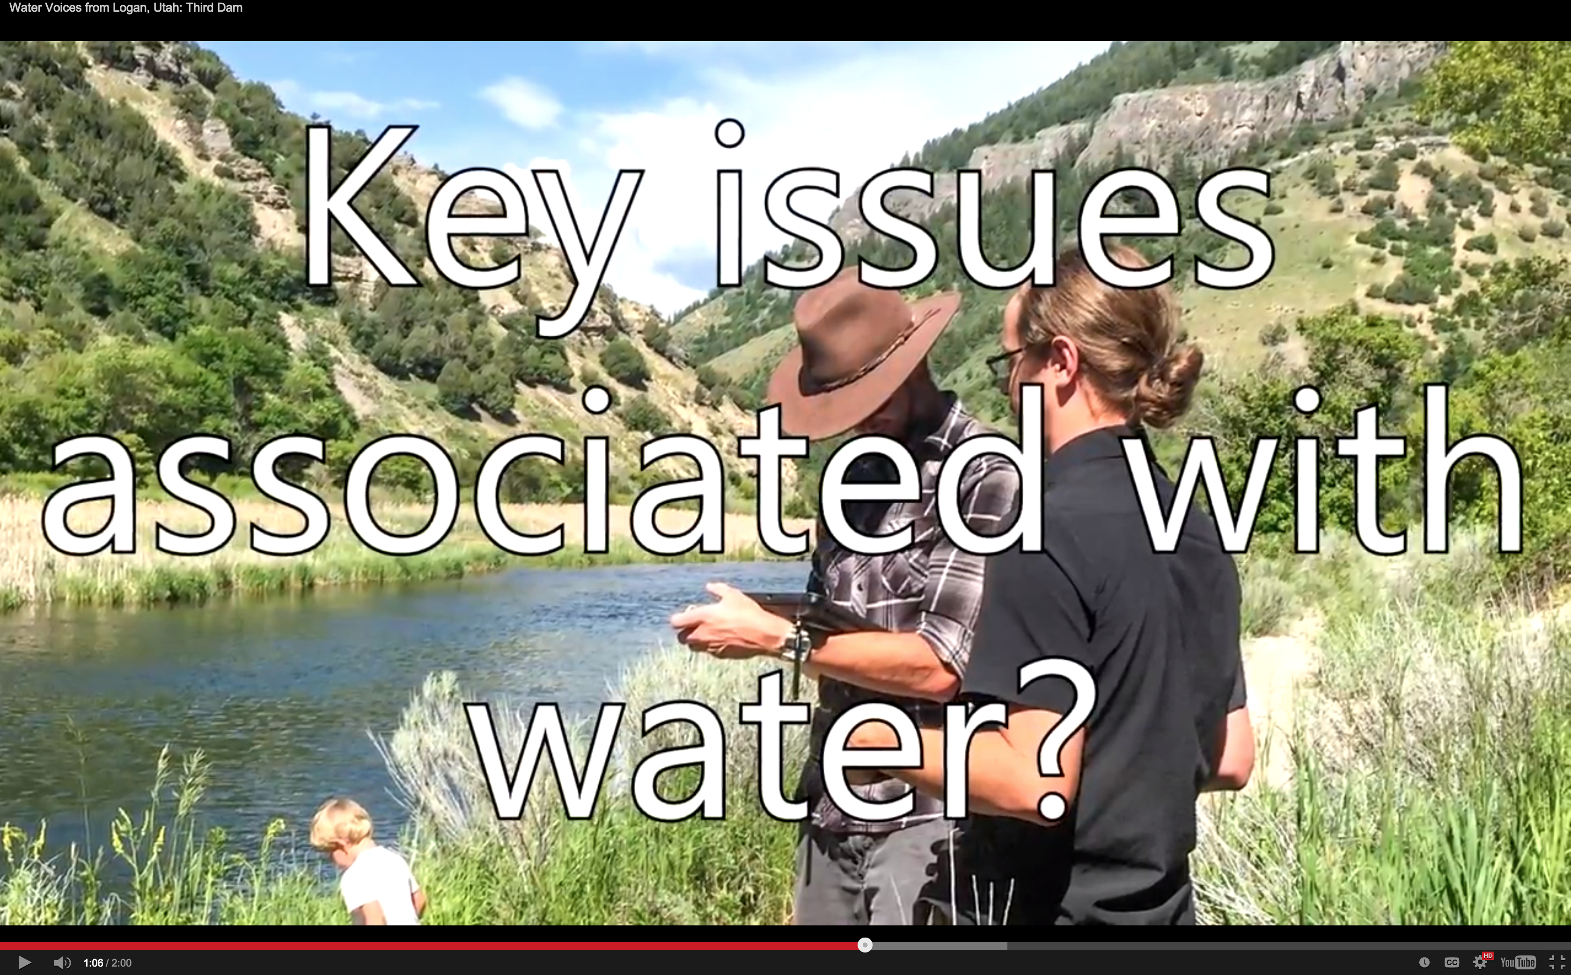
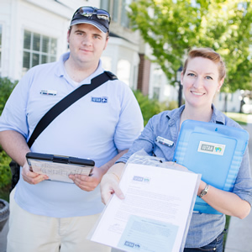
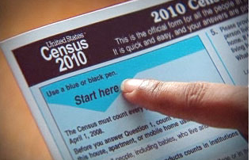
Social Water Science Data
PRIMARY
Stormwater manager interviews and surveys
UNRESTRICTED
Neighborhood typology
Stormwater manager interviews and surveys
NOT HUMAN SUBJECTS
Institutional water use data
Public intercept surveys
Public intercept surveys
RESTRICTED
HUMAN SUBJECTS
UNRESTRICTED
Water pricing data
Household water use data
Water infrastructure project records
Census data
Household water use data
SECONDARY
Census data

Slide 6
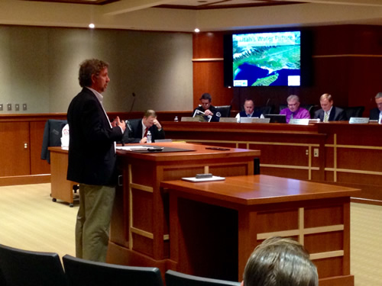
Social Water Science Data
PRIMARY
Institutional water use data
UNRESTRICTED
Neighbor- hood typology
Neighborhood typology
Stormwater manager interviews and surveys
Public intercept surveys
Key informant interviews
NOT HUMAN SUBJECTS
Institutional water use data
RESTRICTED
HUMAN SUBJECTS
UNRESTRICTED
Water pricing data
Water pricing data
Household water use data
Census data
Water infrastructure project records
Water infrastructure project records
SECONDARY

Slide 7


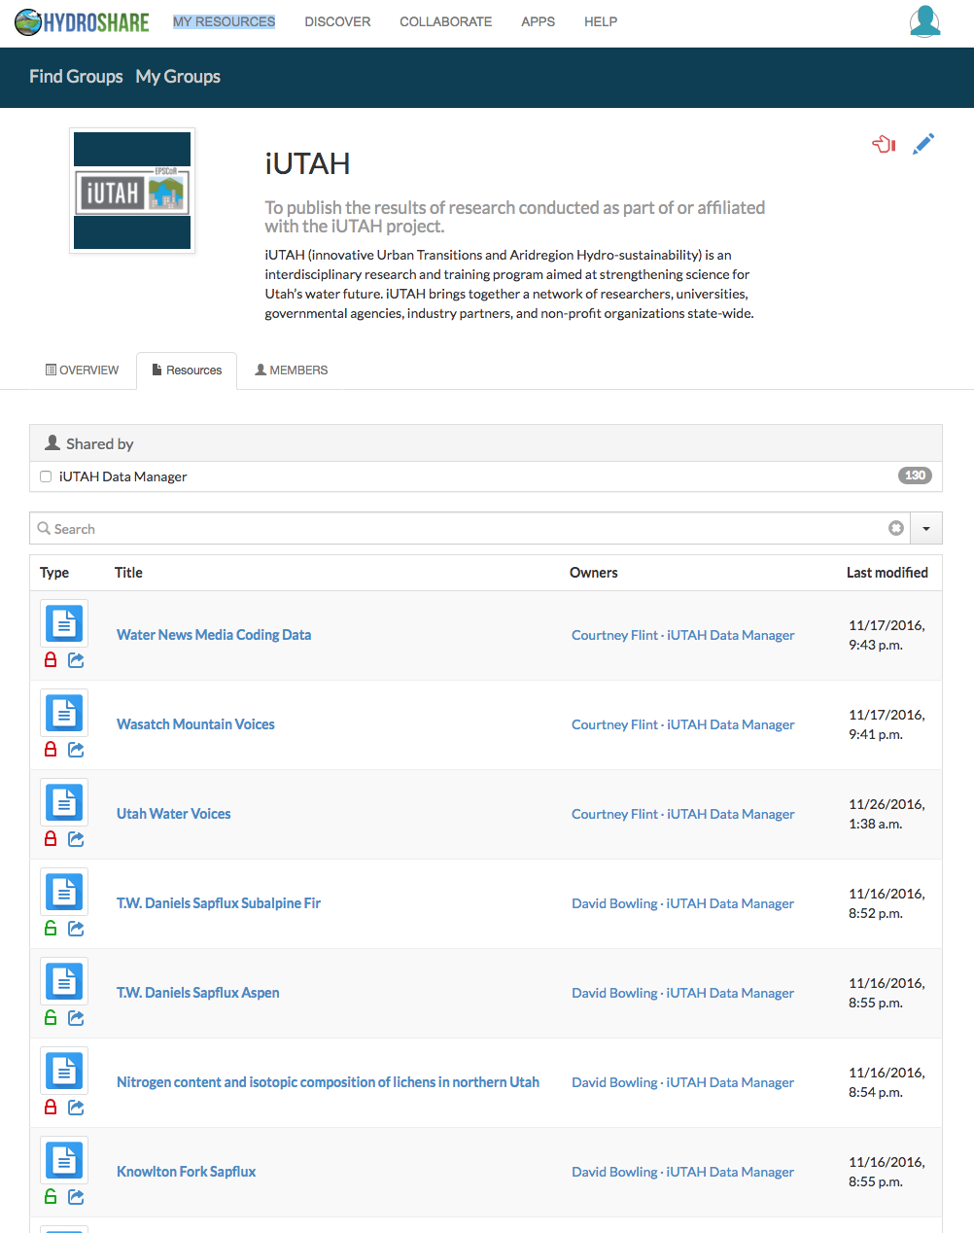
Social Water Science Data Considerations
Research should be designed so that resulting data are available as broadly as possible.
Redaction, de-identification, aggregation should be conducted to anonymize human subjects data.
When anonymization is impossible, a summary report should be generated.
Sharing of coded data from qualitative information is encouraged, but not required as an analysis product.
Data should be shared in a public repository with complete metadata and provenance.
Notes:
We took these practices that impact the sharability and reusability of data and incorporated them into our project data policy. This gave us a way to communicate considerations and best practices that social scientists may already be familiar with, but that may be new to other scientists.
Particular to social science data, the policy encourages research that makes data available to the broadest audience possible while accounting for the sensitivity required for human subjects’ data.
HydroShare is a useful repository for sharing iUTAH data because:
Flexible data model accepts any file type- can accommodate social science datasets alongside biophysical data
Consistent general level metadata with extensibility to include additional metadata elements specific to a data type (e.g., alterations to secondary data)
Support for collaboration- sharing with individuals, groups, or publically and ability to formally publish with a DOI.
PIVOT: our policy and our typology for social water science data informed our understanding of the characteristics and limitations of data types, and also how these datasets might be made more broadly available.

Slide 8
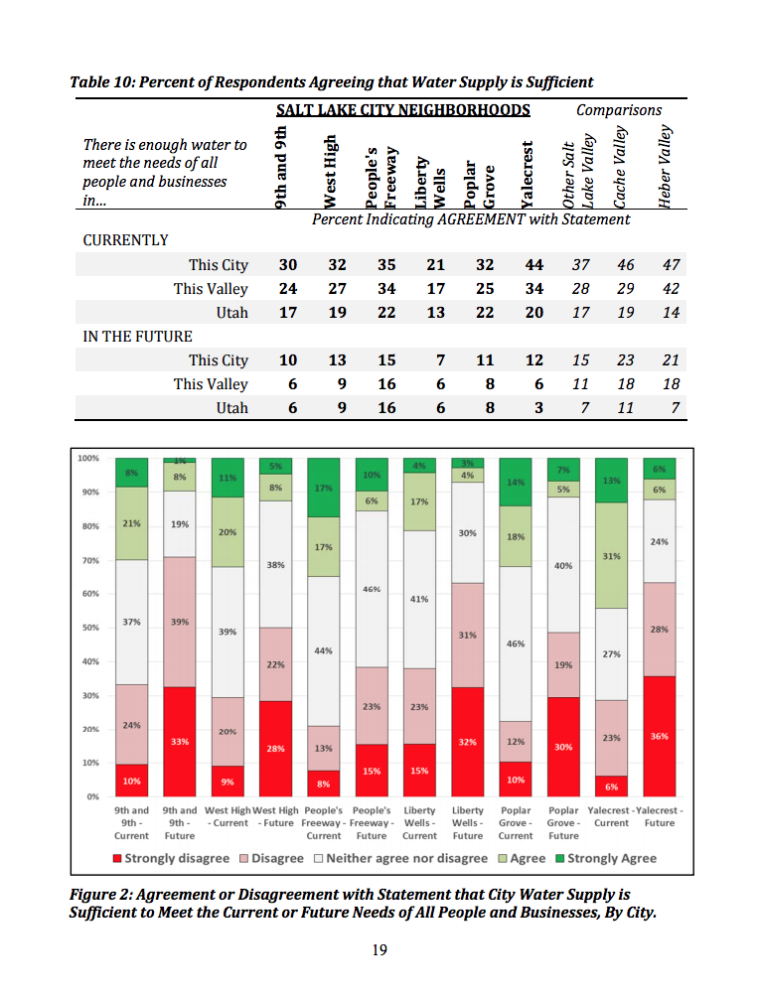
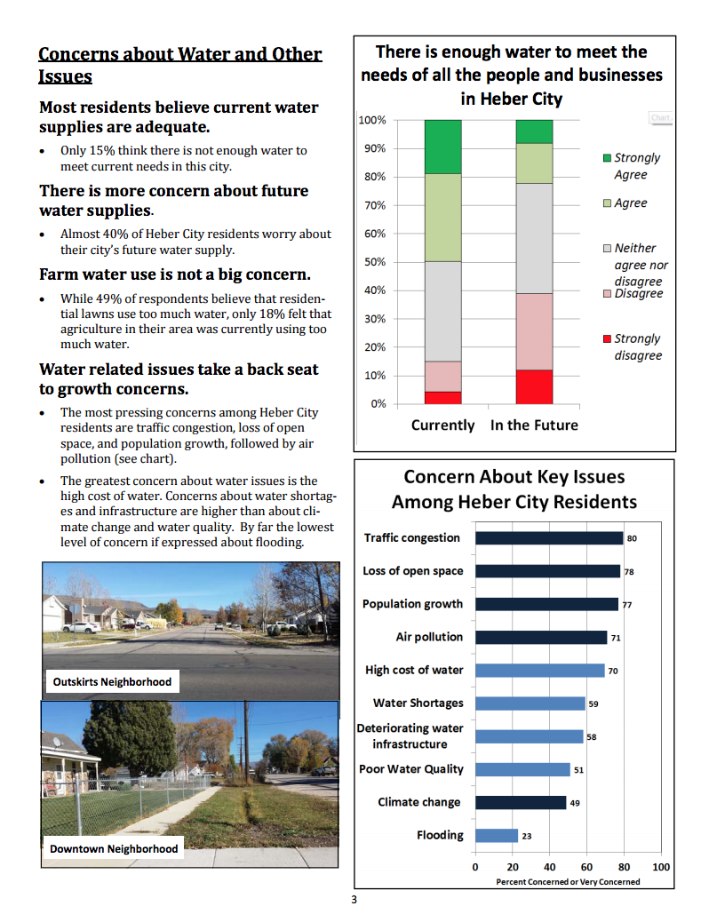
Case Study: Social Science Survey Data
PRIMARY
UNRESTRICTED
Public intercept surveys
NOT HUMAN SUBJECTS
RESTRICTED
HUMAN SUBJECTS
UNRESTRICTED
SECONDARY
Notes:
Once we know where a dataset falls in the three dimensions, then data that might have been thought of as off-limits turn out to be appropriate for public consumption, and we start looking at them differently. One example is quantitative survey data. The iUTAH project has implemented several surveys to assess attitudes and perceptions to water issues.
These extensive surveys with rich information in the results were published as summary reports. Steps were taken to make sure the information was accessible, but the reports were the only mechanism to interact with these data.
This particular dataset shows up in the typology is here- it’s a primary dataset, and though it contains human subjects data, it’s unrestricted- there is nothing keeping these data from being more widely shared.

Slide 9
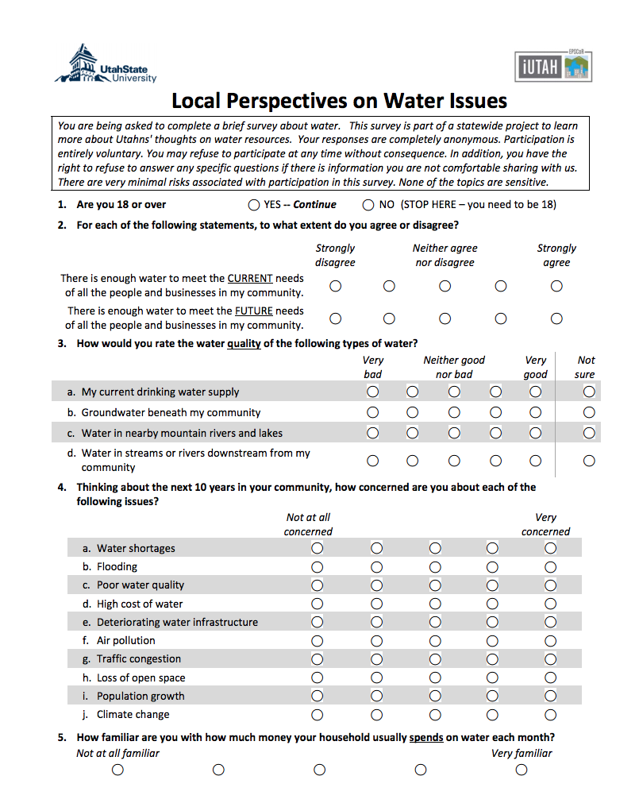
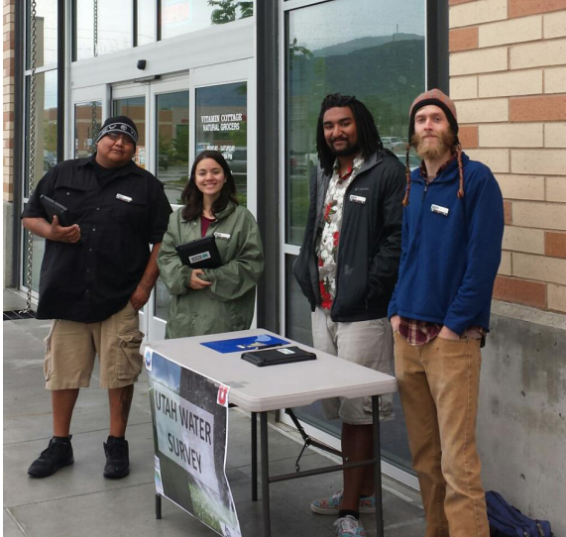
Case Study: Social Science Survey Data
Survey Data Viewer Objectives:
Tool for quantitative survey data
Easily add new survey results
Available to broad audience
Interactive
Web-based
Notes:
With a static report, there’s no real opportunity for stakeholders or others to interact with and explore the dataset. However, there’s nothing to prohibit this other than a lack of tools available for doing so. To meet this need and get make these datasets more accessible, we built a tool.

Slide 10
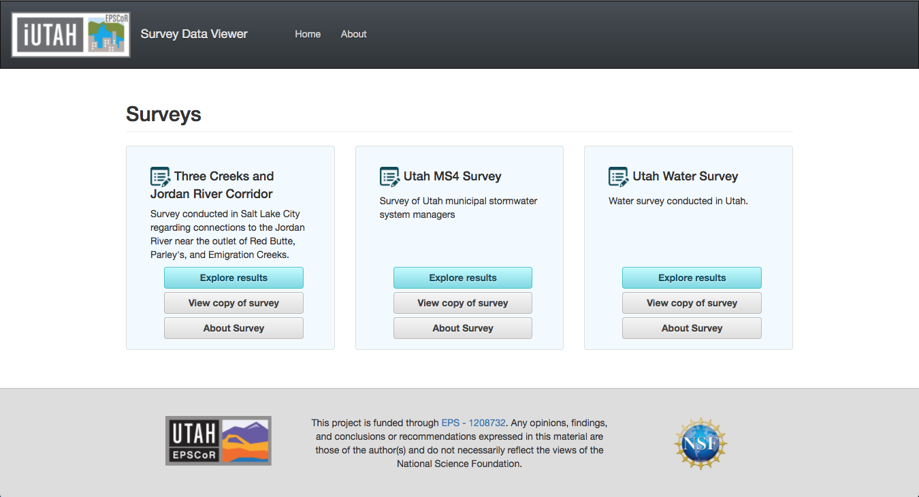
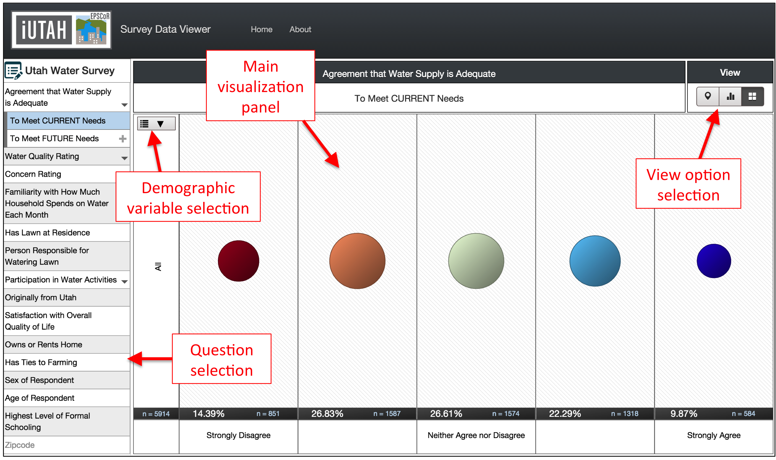
Case Study: Social Science Survey Data
Notes:
The first page displays the set of surveys for which the Survey Data Viewer has been deployed. I will talk about a couple of these- the Utah Water Survey is the public intercept survey conducted at grocery stores on ipads. The Three Creeks study was specific to the neighborhoods near the confluence of three creeks to the Jordan River in SLC.
The second web page is the results viewer interface for exploring the results of the selected survey. This consists of a panel on the left side of the screen listing the survey questions, and the main visualization panel that presents the results.
Buttons in the Results panel allow users to select visualization options. The next few slides show features and options of the viewer.

Slide 11
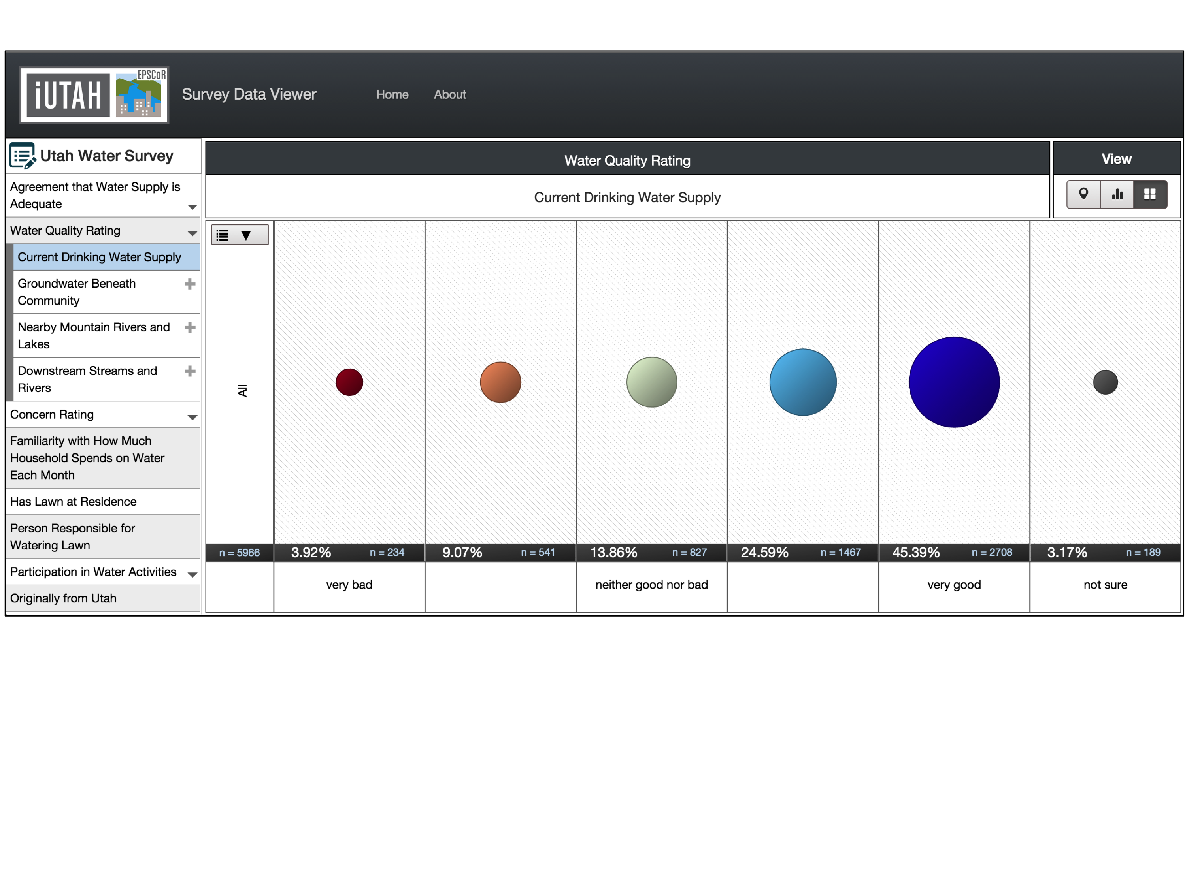
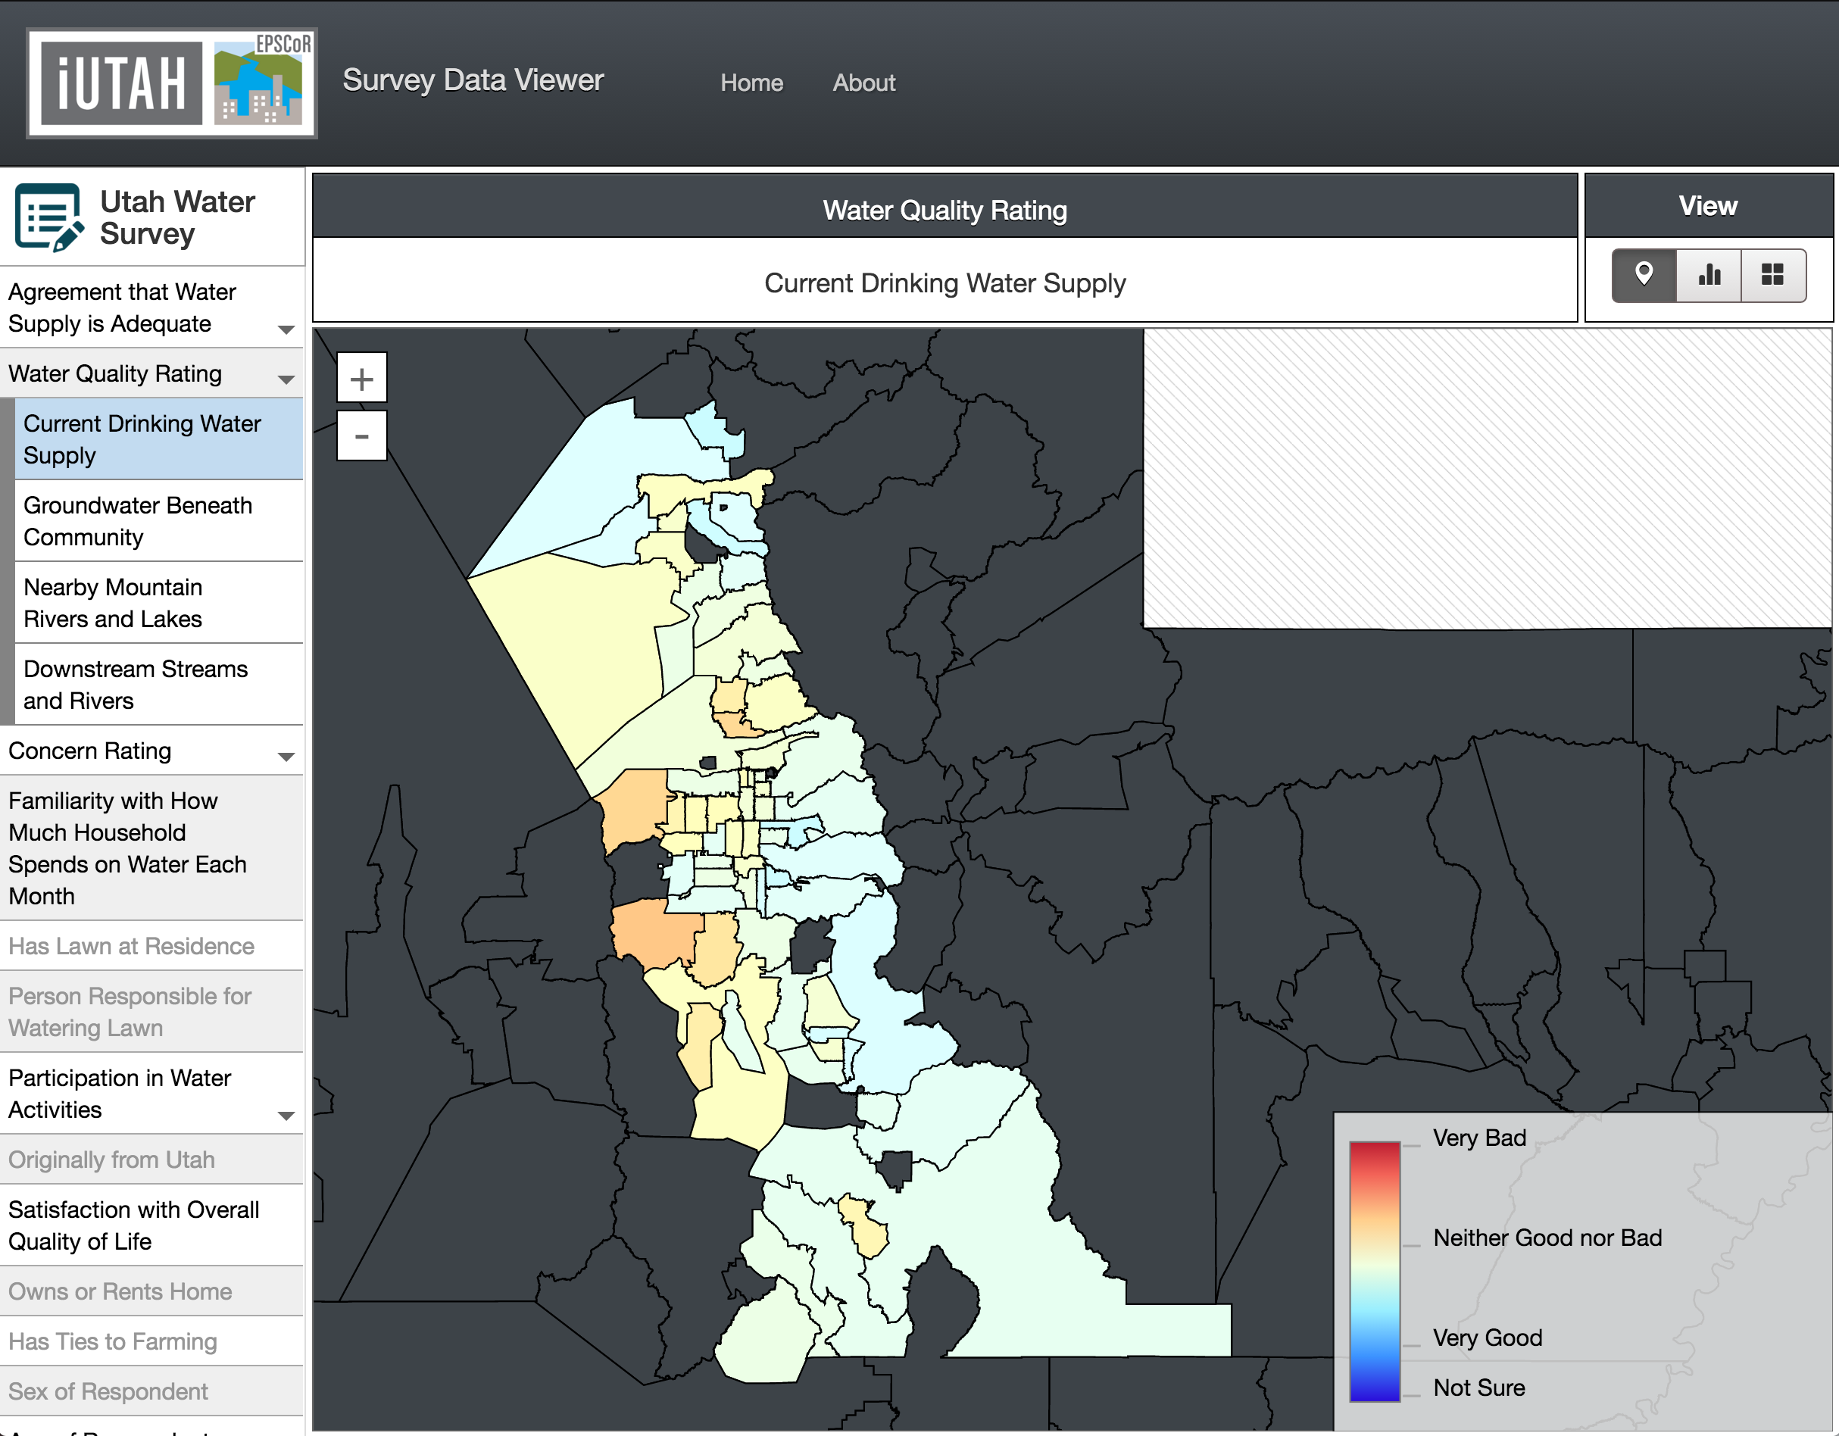
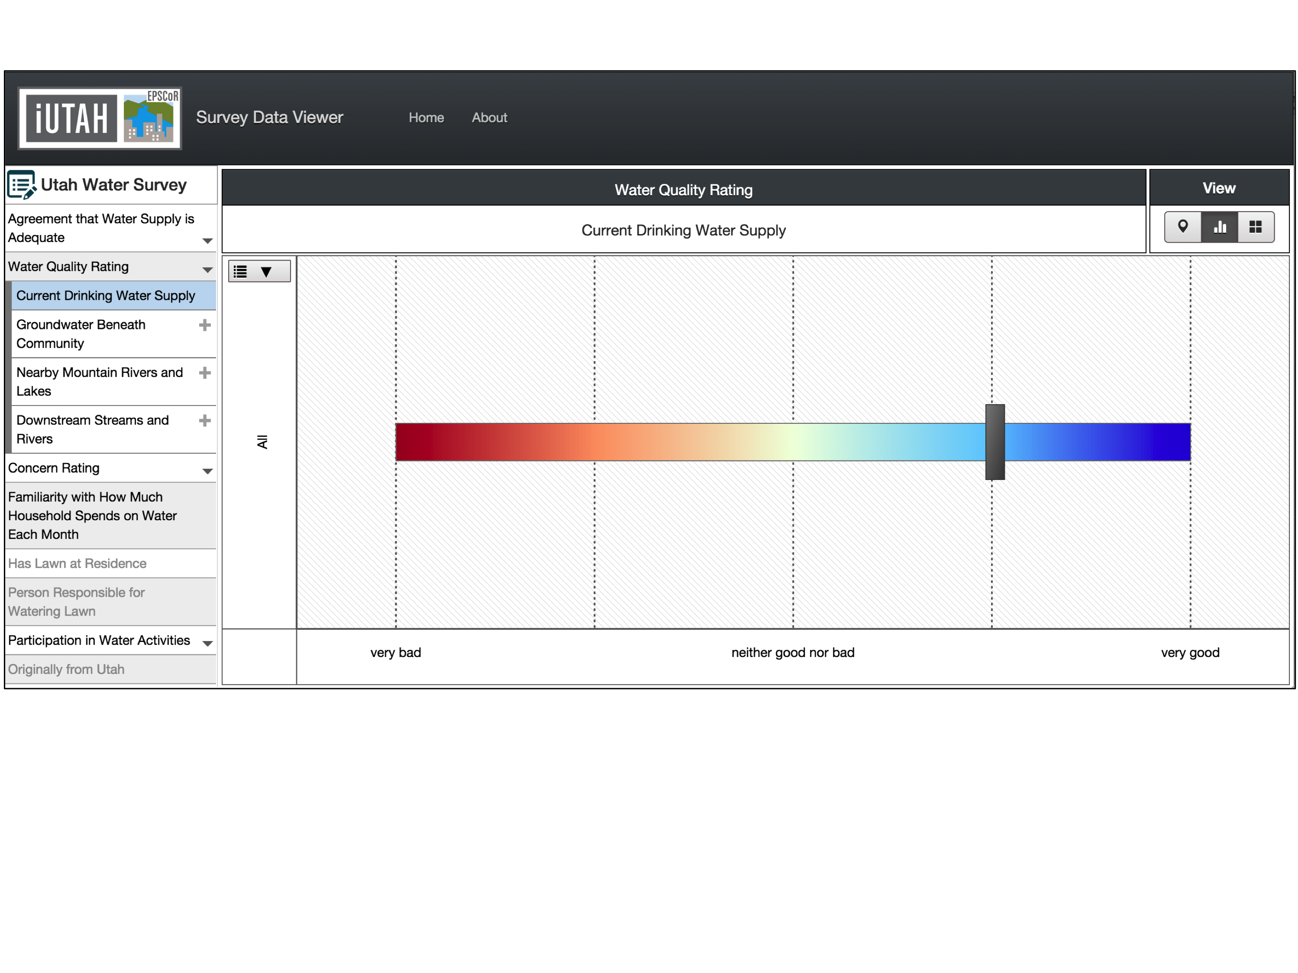
Case Study: Social Science Survey Data
Percentage and count of respondents
Response categories
Notes:
The Survey Data Viewer allows users to visualize responses in terms of the percentage of respondents falling into each response category.
Here is a focus on the x-axis with the categories labeled.
The circles are sized to indicate the percent distribution of survey responses. The numeric percentages and total numbers are shown in the axis.
The mean data view illustrates the mean score of all respondents for a question.
It may be important to explore how the geographic characteristics relate to responses. The Survey Data Viewer uses a map to illustrate spatial patterns of mean responses to survey questions.
This slide shows three different views of the same question.

Slide 12
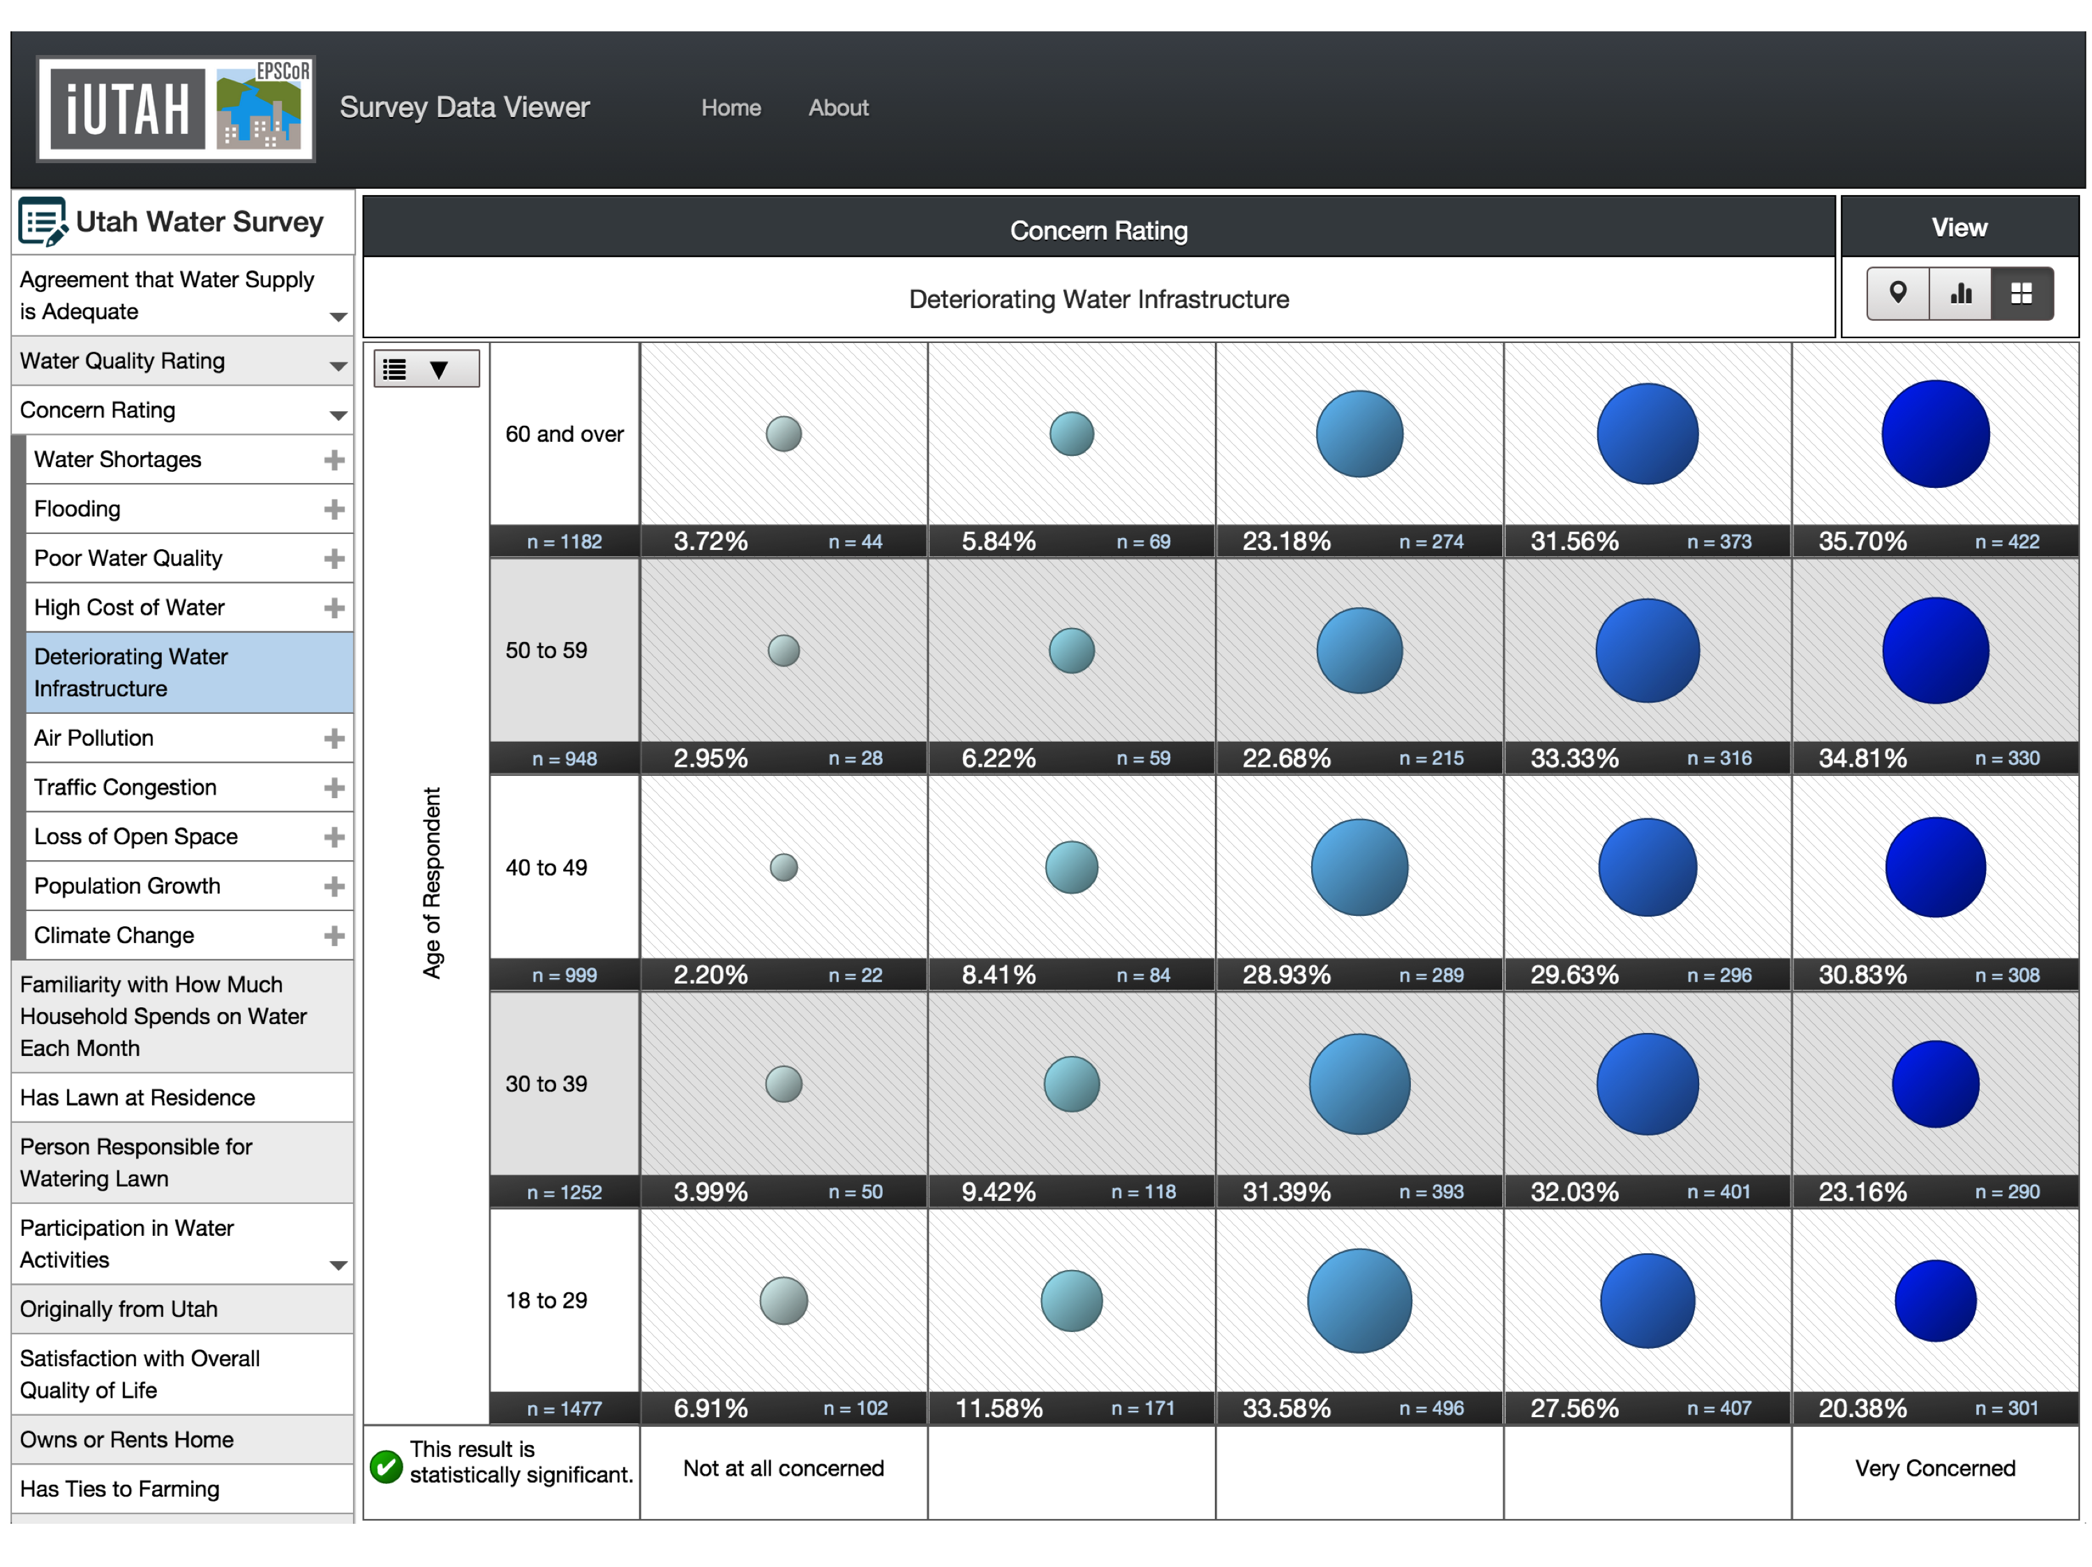
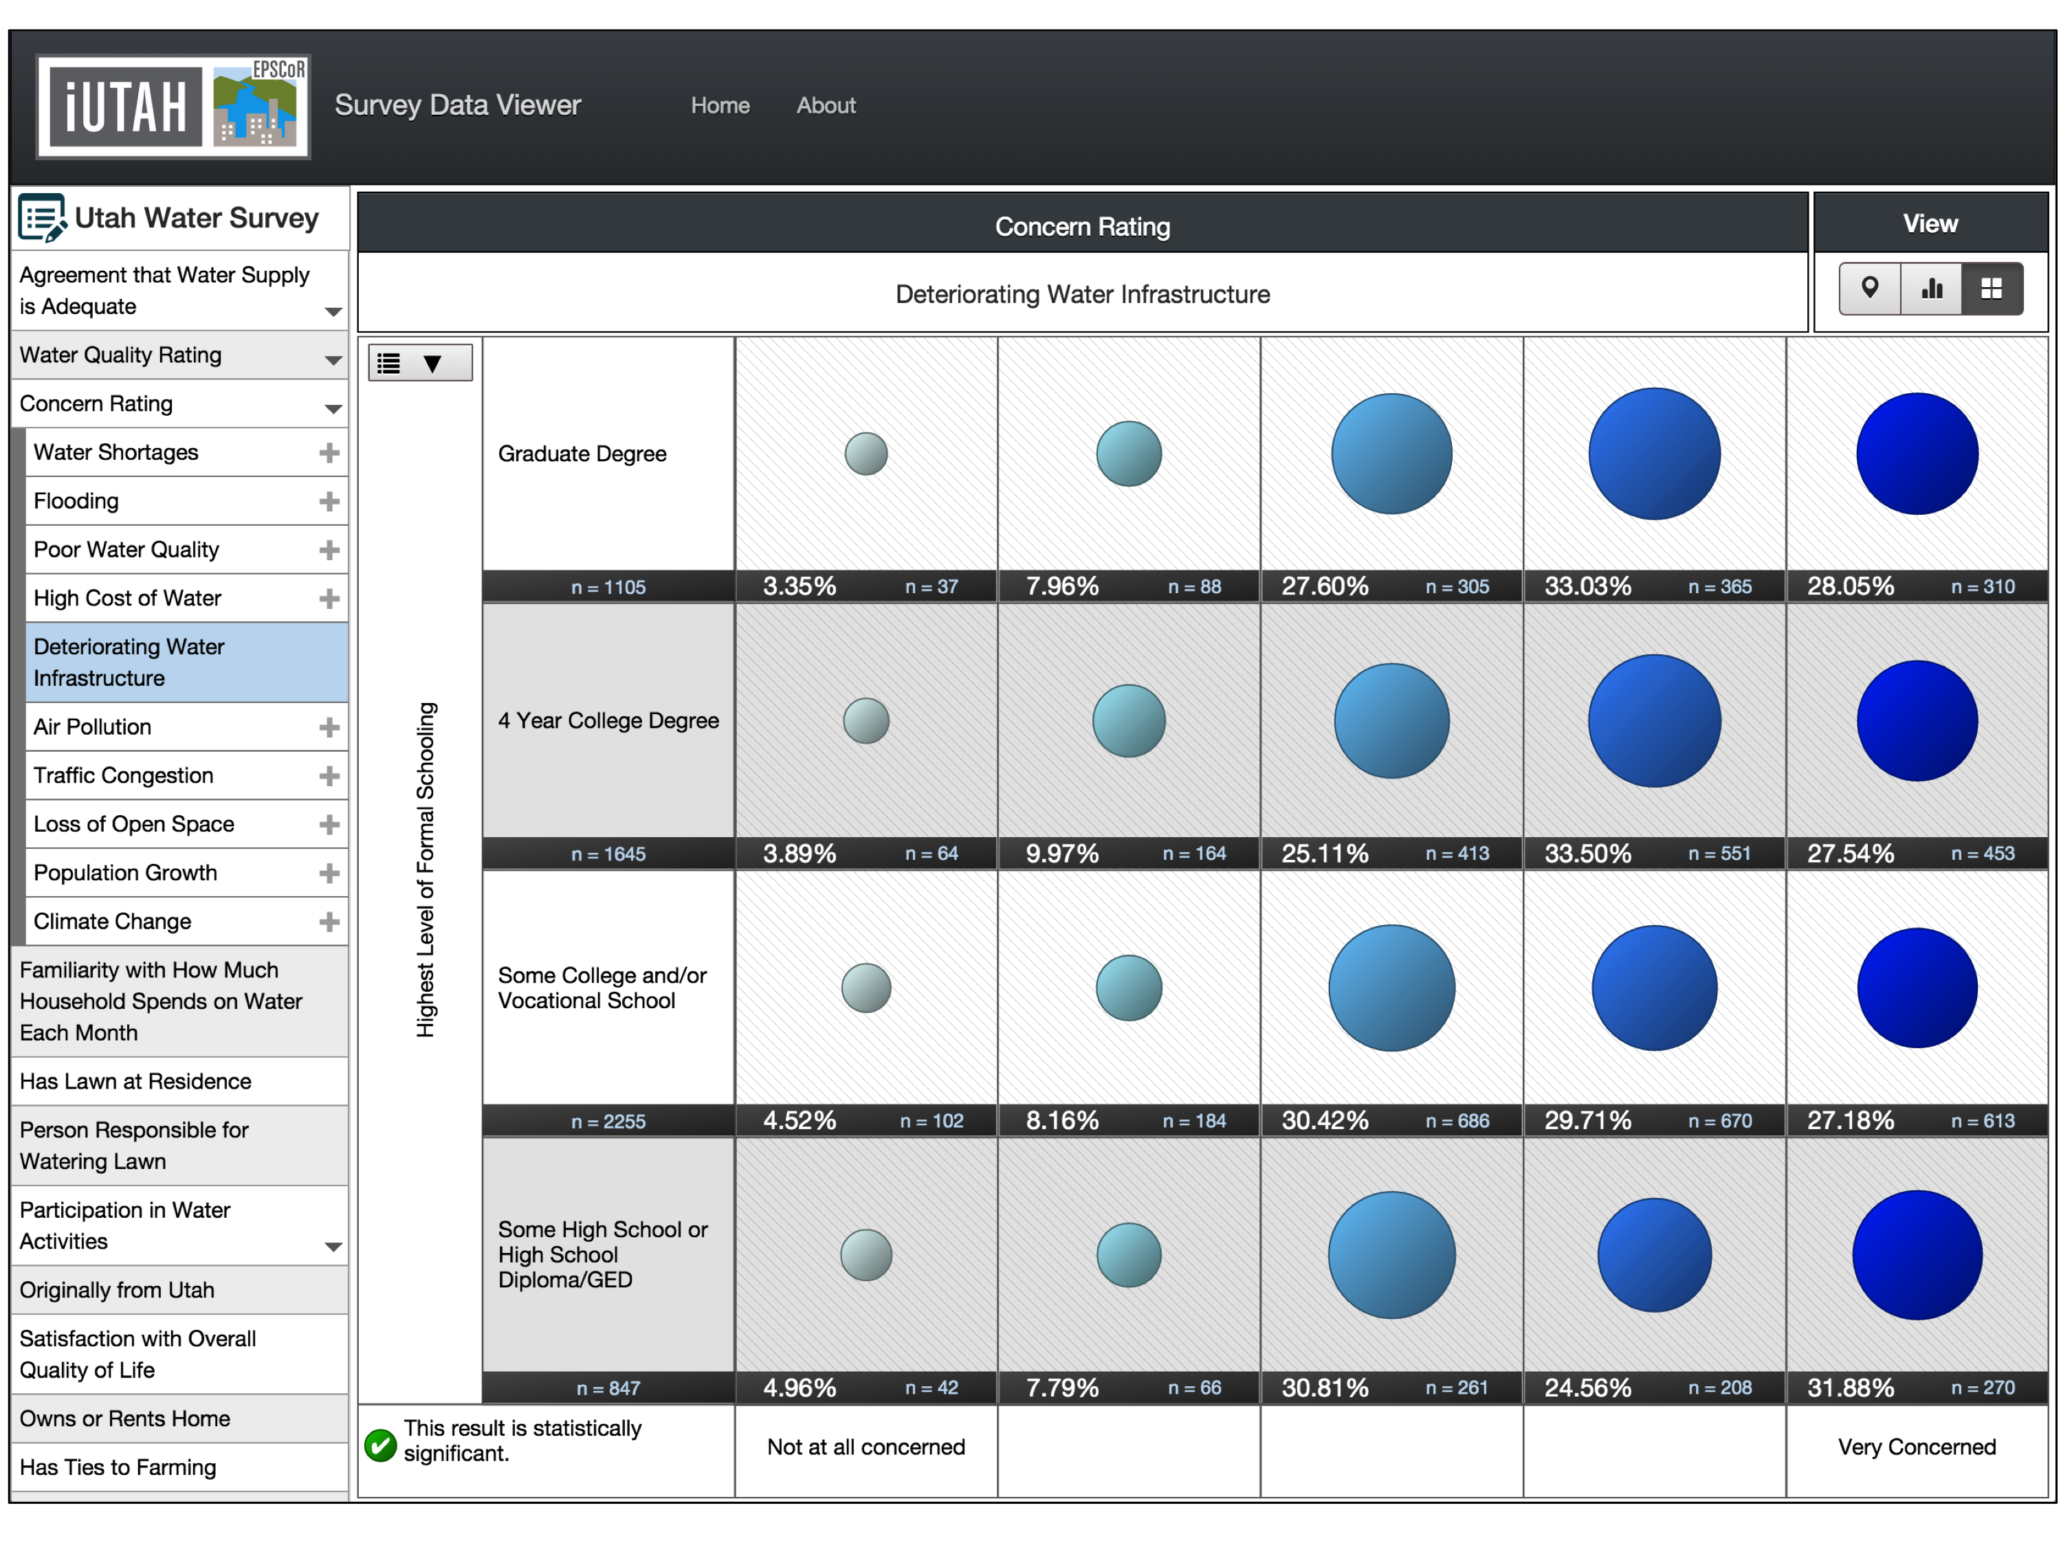
Case Study: Social Science Survey Data
Disaggregated by Level of Schooling
Disaggregated by Age of Respondent
Notes:
When attributes of respondents are included in survey data, perspectives can be aggregated and disaggregated to understand commonalities and divisions.
In this case, we have the same question selected but divided by respondents’ age and respondents’ highest level of education.

Slide 13
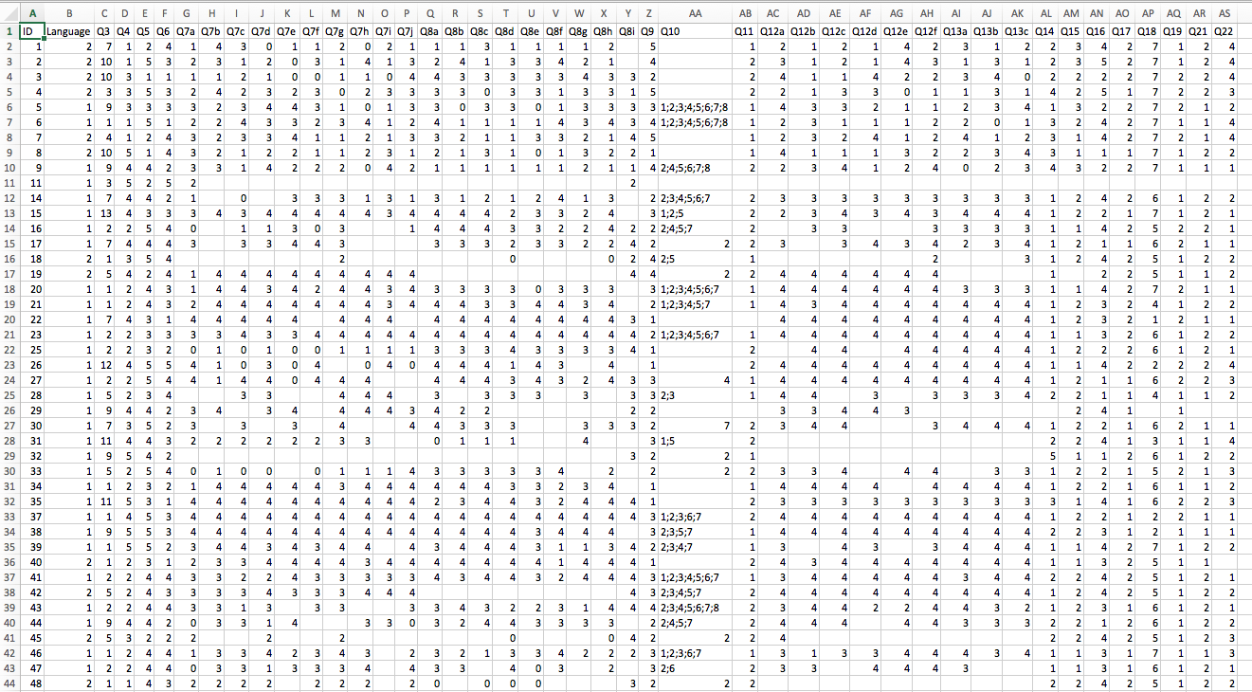
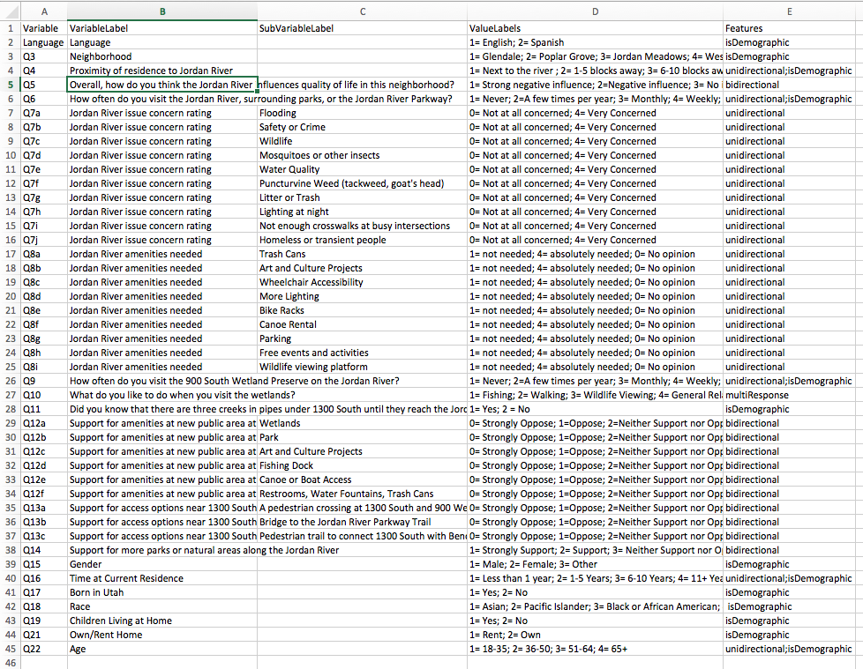
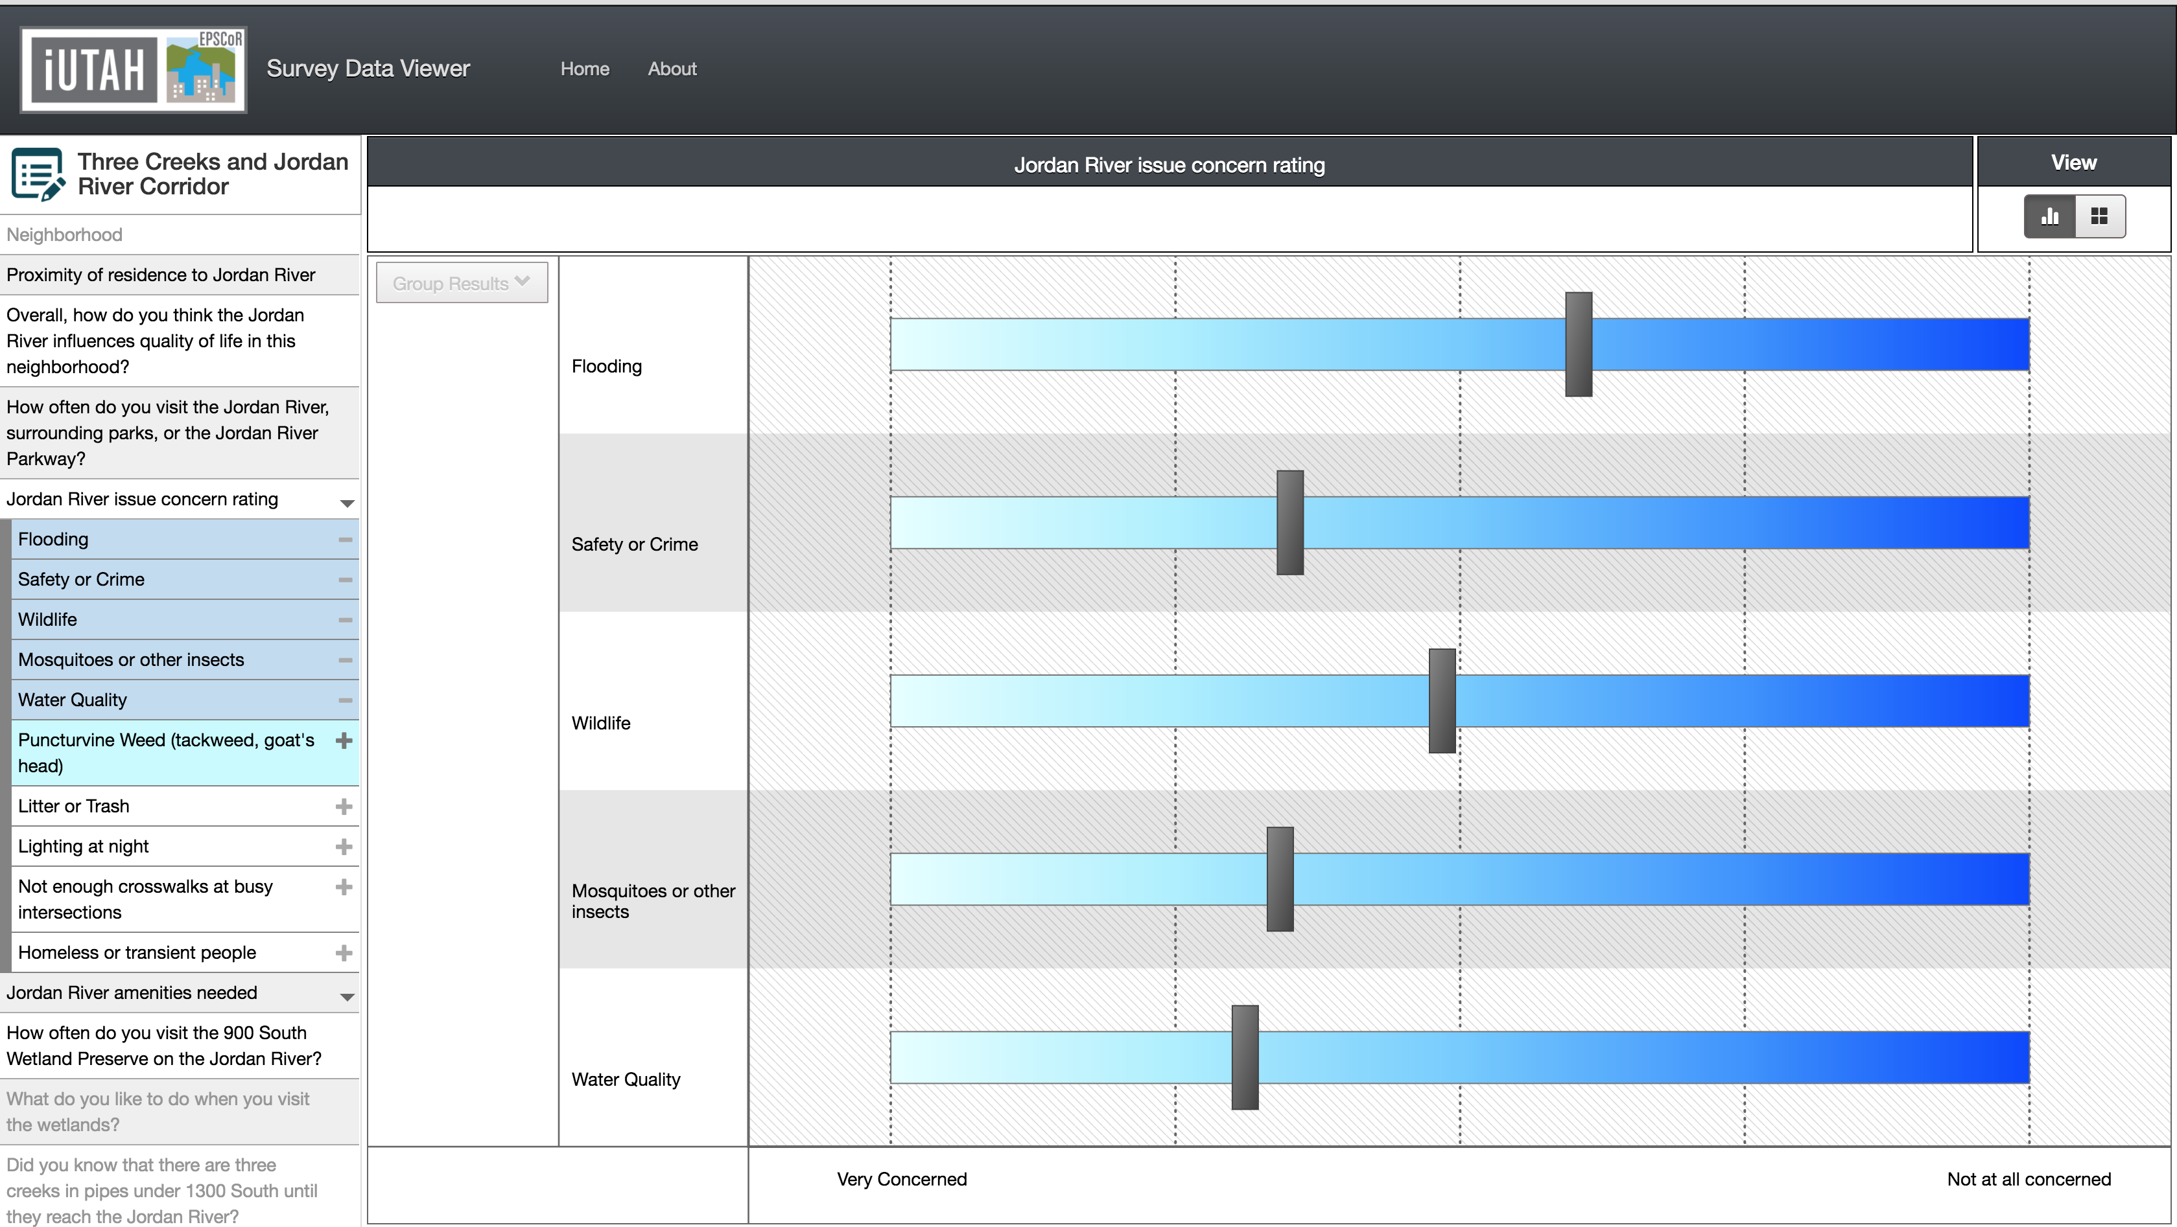
Case Study: Social Science Survey Data
Survey Data Viewer:
Generalizable and reusable for other, similar surveys
Uses a standardized template for encoding survey data and metadata
Rapidly deploy new survey results to the web for immediate exploration and visualization
Notes:
The Survey Data Viewer was designed to be generalizable to any quantitative survey dataset.
The only thing we need to to is create these two files, which are encodings of the survey data and metadata in straightforward formats
Once these are formatted, it is simple to deploy a new survey, which we have done for several surveys created under the iUTAH umbrella.

Slide 14
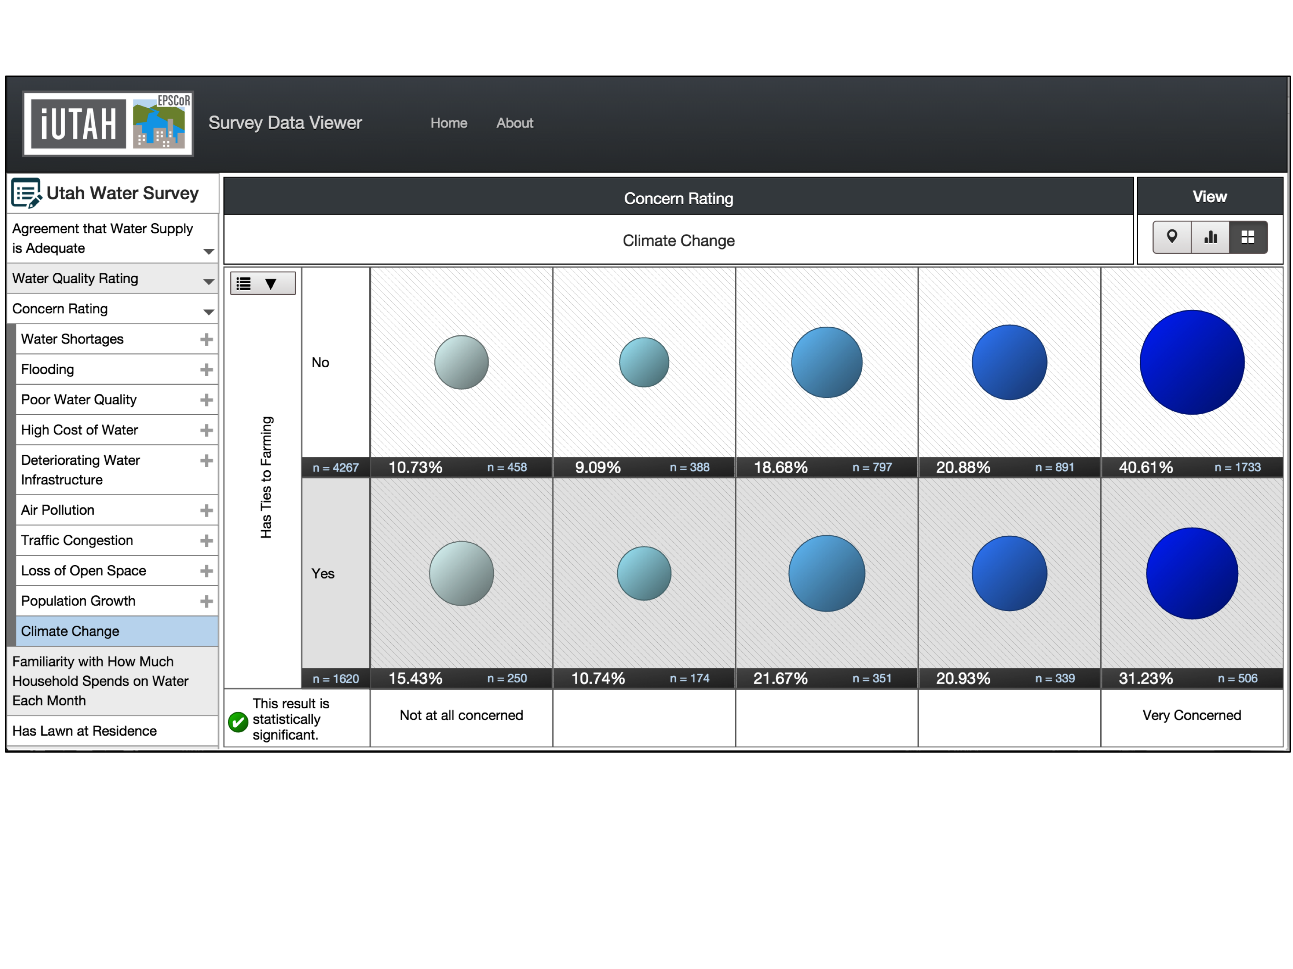
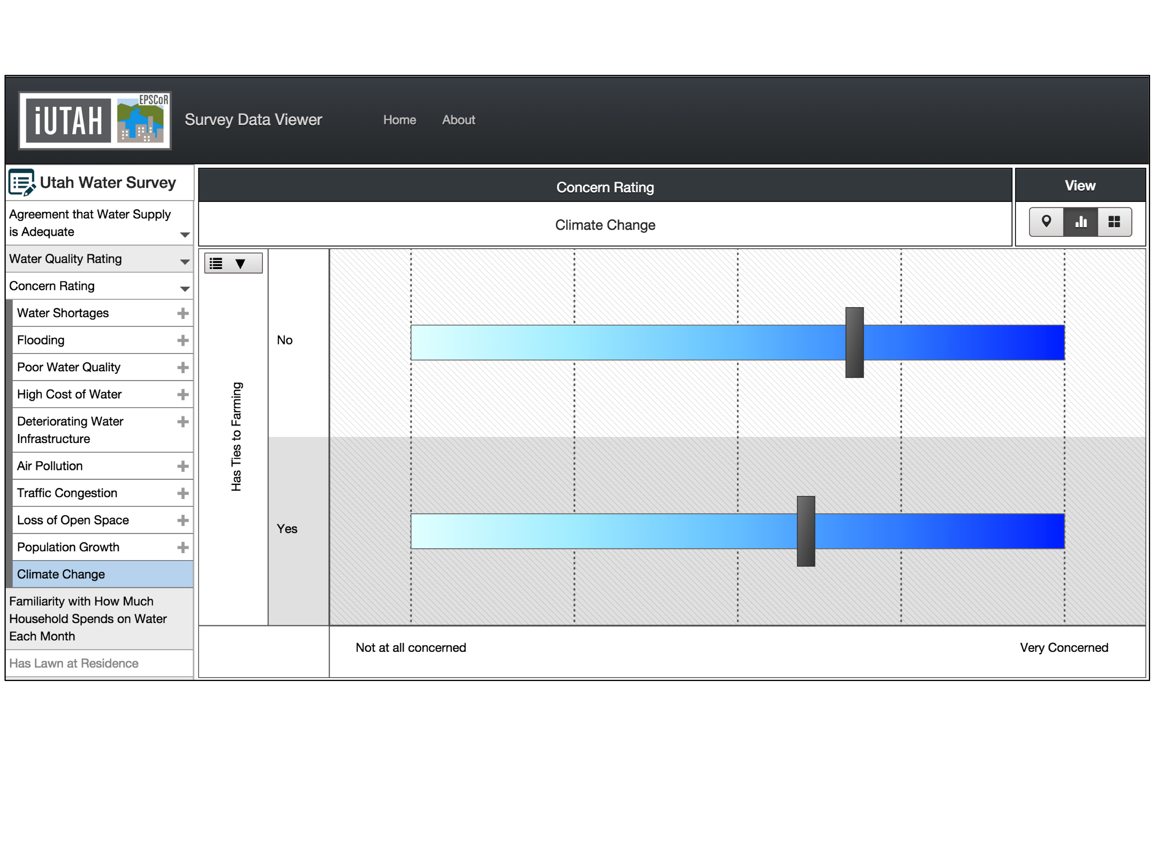
Survey Data Viewer in Practice
Notes:
How can the survey data viewer be used?
The ability to visually explore these data and quickly interact with the results has helped launch further investigation into some unexpected results of the Utah Water Survey.
Here is an example- participants with ties to farming were less concerned about climate change and air pollution than those without farm ties
It can be seen in the circles in percentage view- it is also observed in the mean score view.

Slide 15
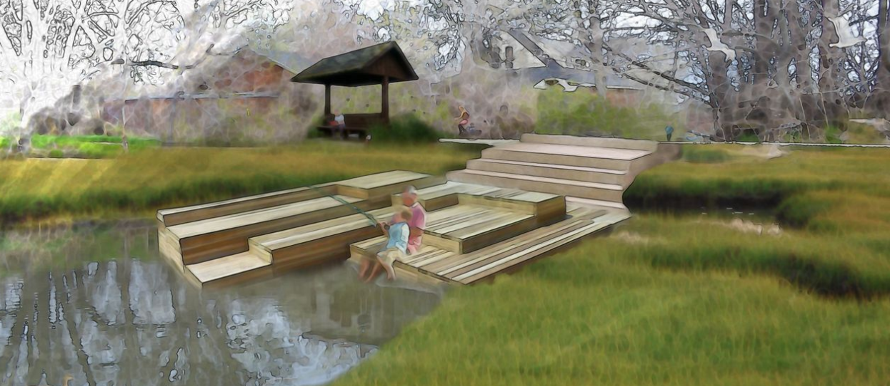
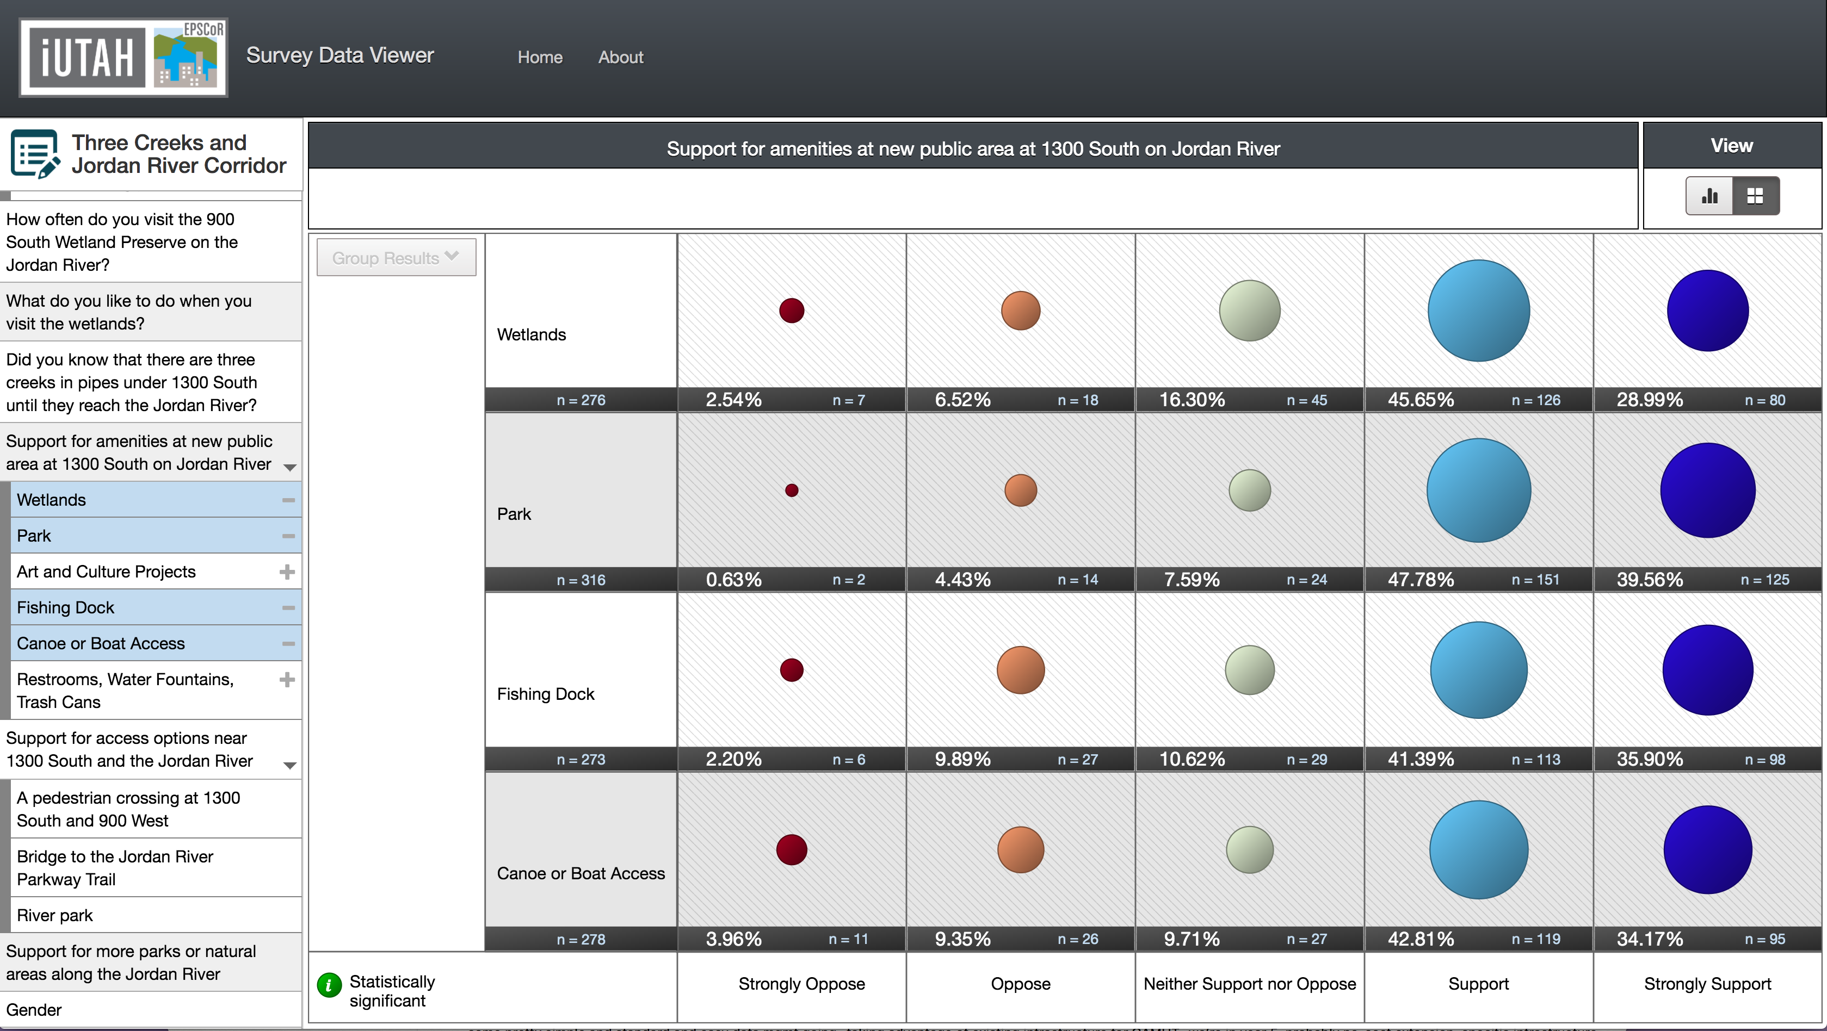
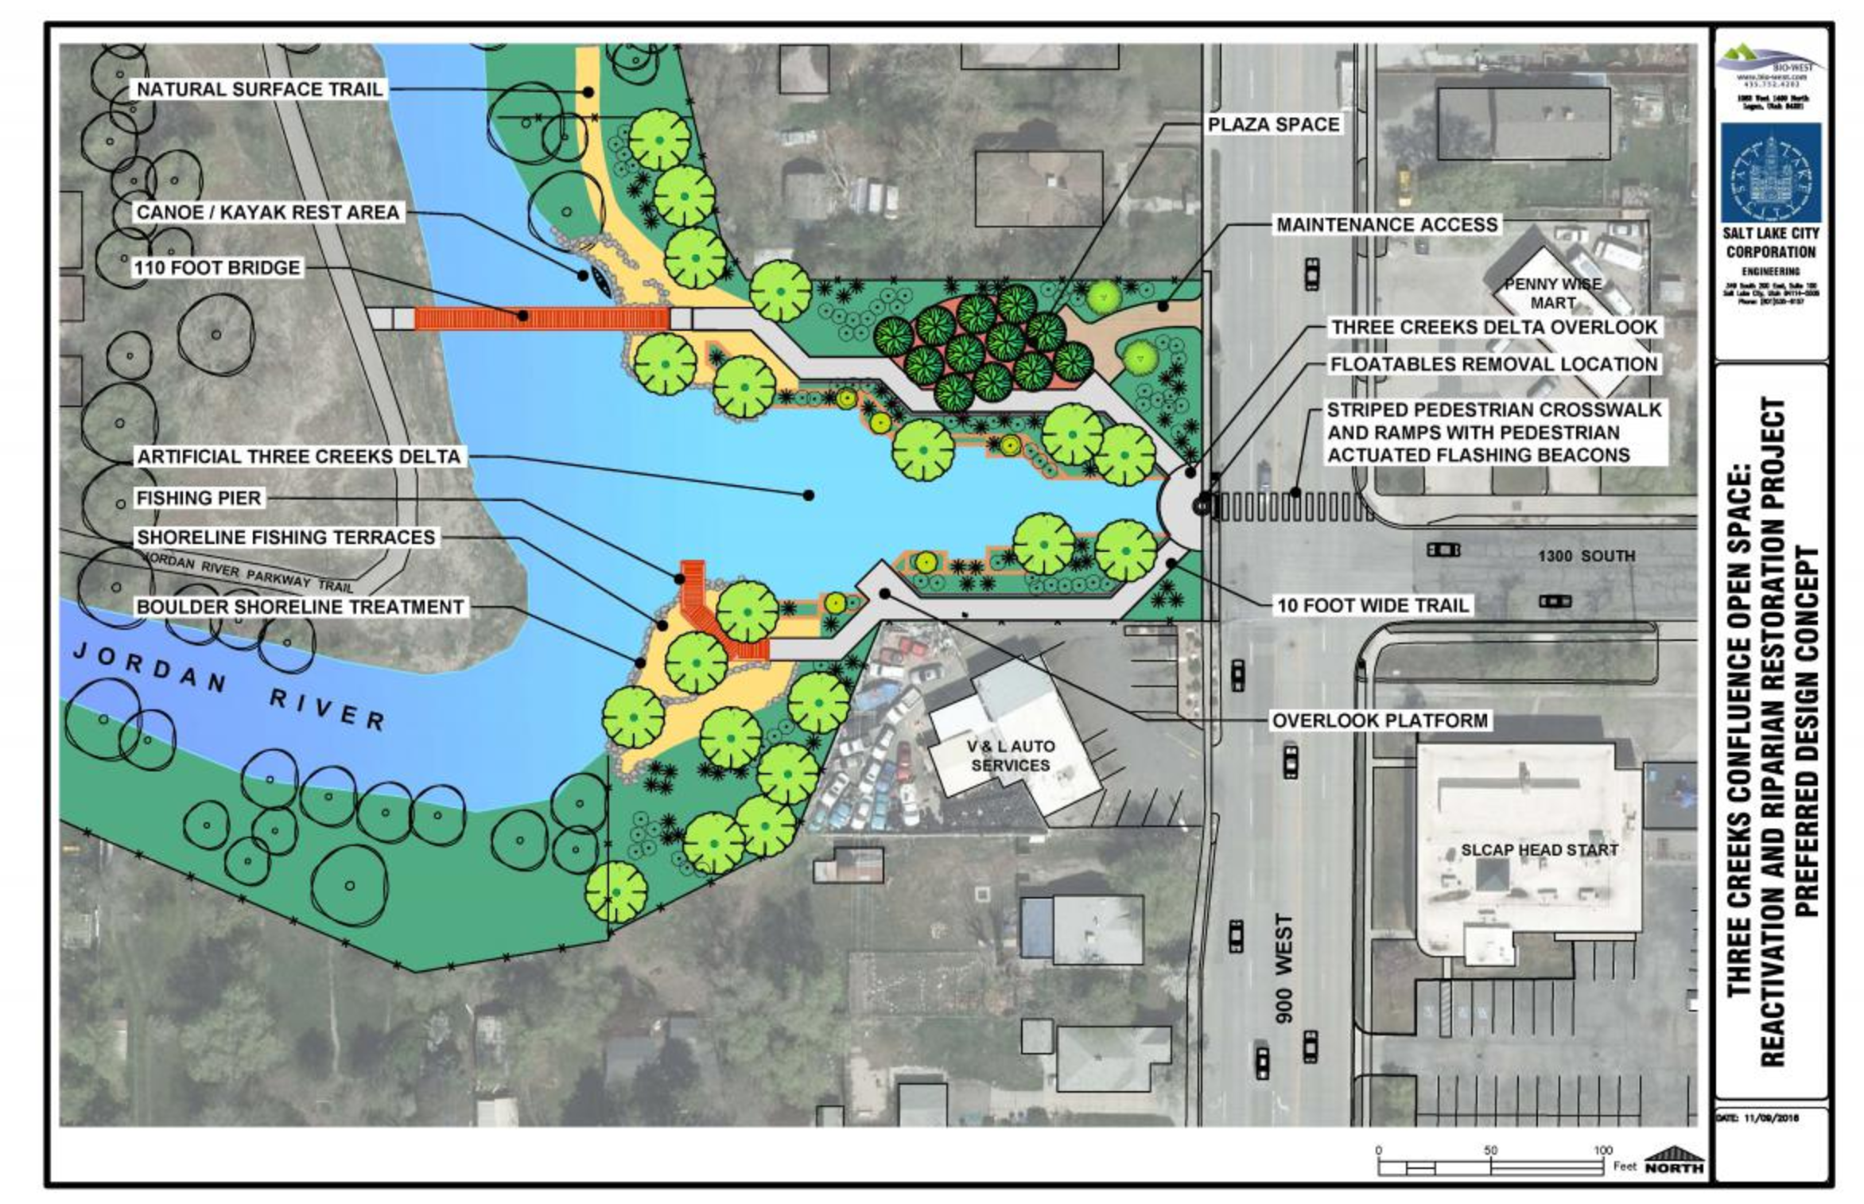
Survey Data Viewer in Practice
Notes:
How can the survey data viewer be used?
For the Three Creeks/Jordan River survey, it has been shared in community meetings with neighborhood council groups to show the data and to answer questions. The viewer was used as a tool that facilitated discussions. As part of this process, SLC parks were able to gage public interest in developing a river park, which led to a Community Development Block Grant. The features planned for implementation have strong support from survey respondents, as shown here in the Survey Data Viewer.

Slide 16

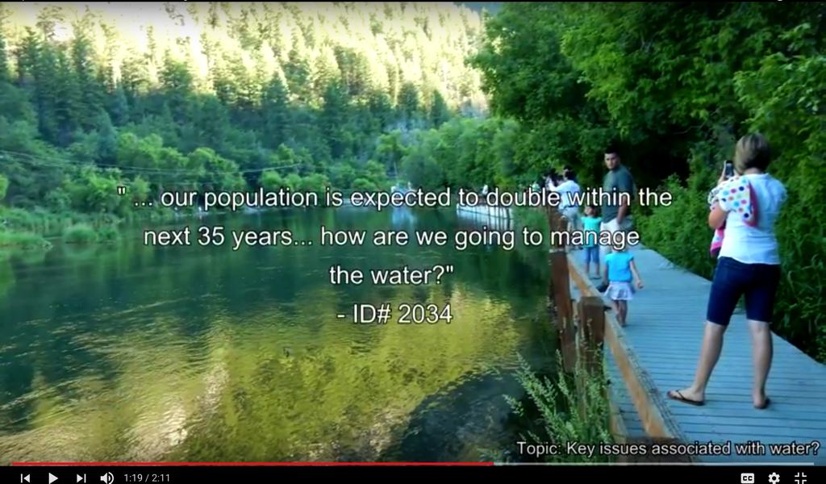
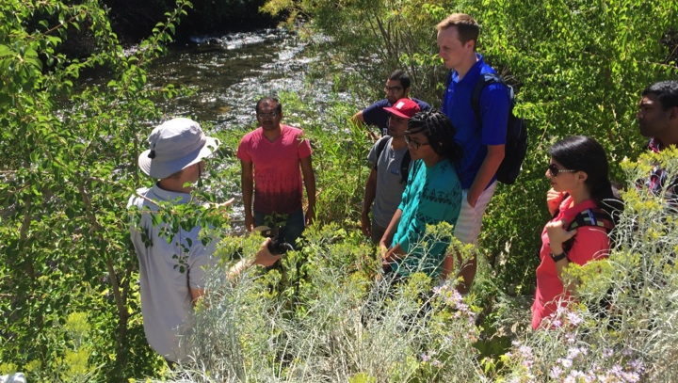
Social Water Science Data: So What?
Decisions made early in the data collection and planning process will enable or constrain options for data use, reuse, and sharing.
Understanding classification and characteristics of data reveal requirements and opportunities for sharing and visualization and implications for data management.
Understanding data types can facilitate communication between scientists of different domains.
Decisions made early in the data collection and planning process will enable or constrain options for data use, reuse, and sharing.
Understanding classification and characteristics of data reveal requirements and opportunities for sharing and visualization and implications for data management.
Understanding data types can facilitate communication between scientists of different domains.
Decisions made early in the data collection and planning process will enable or constrain options for data use, reuse, and sharing.
Understanding classification and characteristics of data reveal requirements and opportunities for sharing and visualization and implications for data management.
Understanding data types can facilitate communication between scientists of different domains.
Notes:
Decisions that you make early in data collection will either enable or constrain what you can do with the data once you have them. You may plan for the data to be inaccessible OR with lack of planning and consideration for data sharing and availability you may inadvertently make data inaccessible.
If it falls somewhere that you don’t want it to be, you may need to re-design your study so that it meets goals or requirements for data sharing.
If you’re careful, it can open up opportunities such as online data interaction.
Establishing management processes for such data diversity not only requires new infrastructural mechanisms, but constructive dialogue to build respect and open-mindedness.

Slide 17

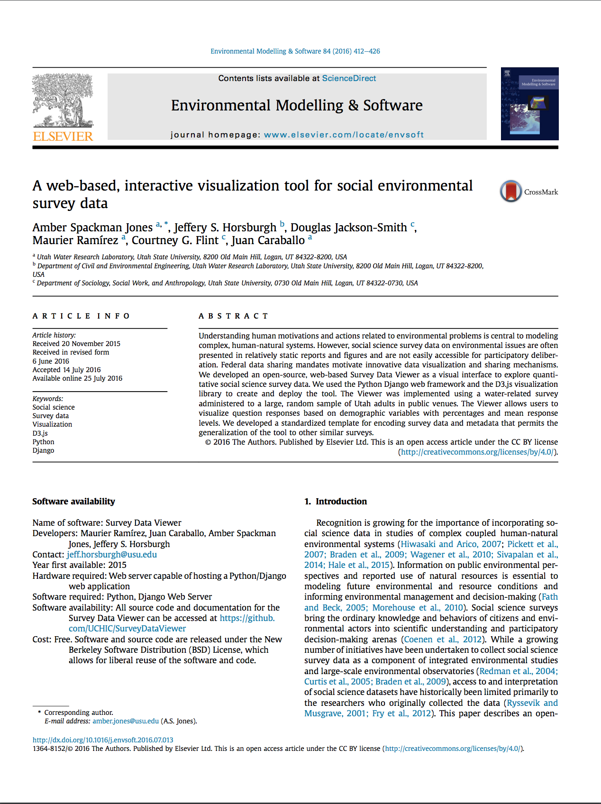
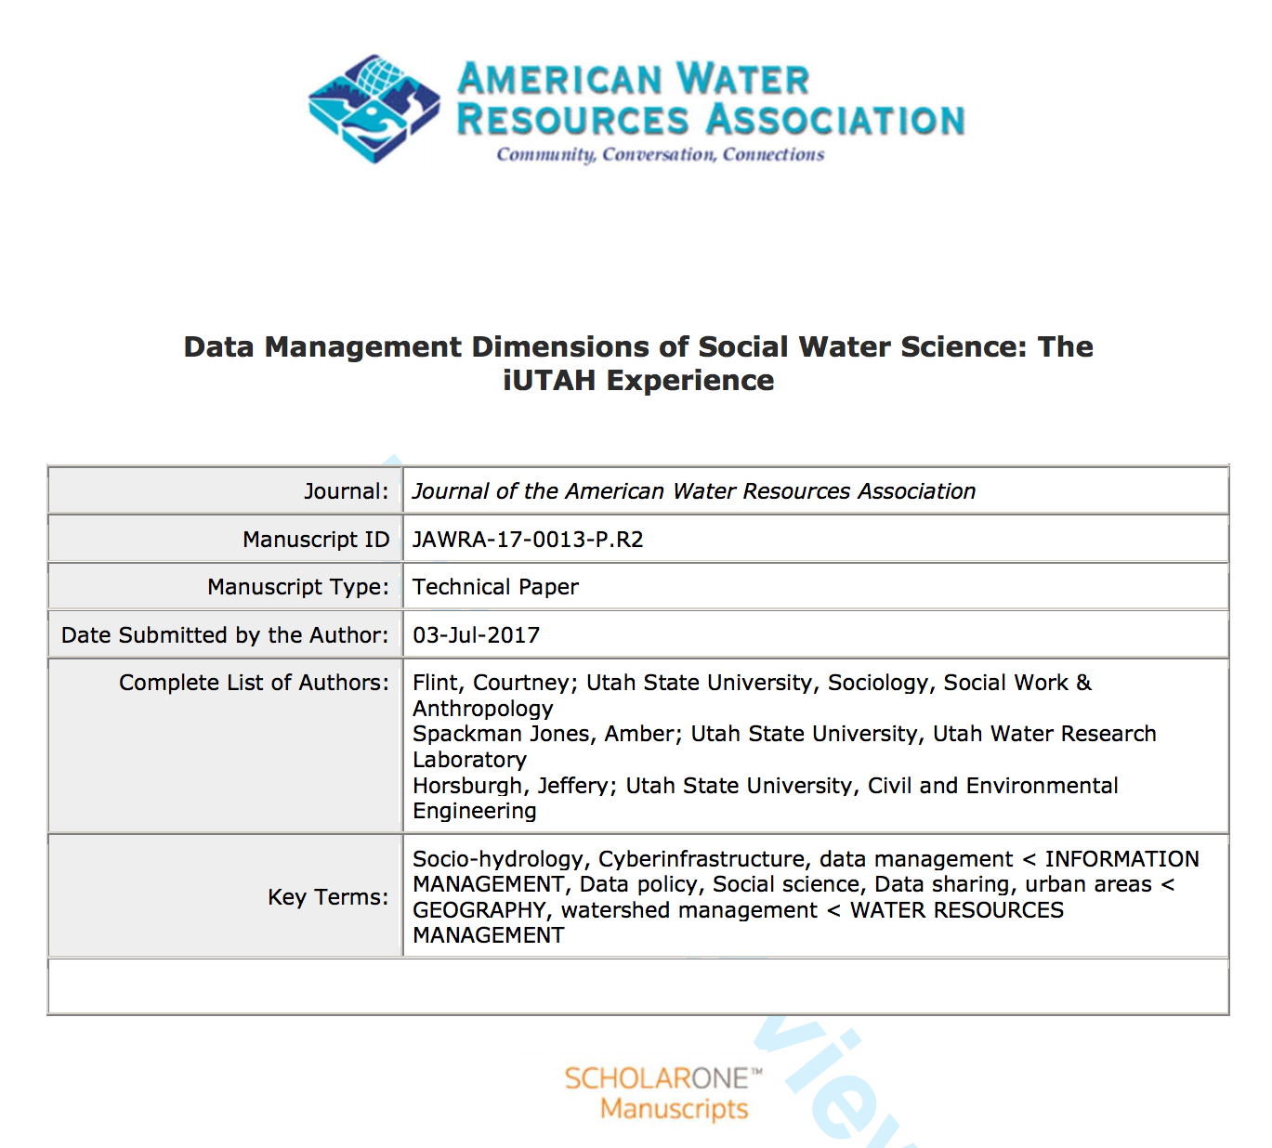
Social Water Science Data: So What?
Important iUTAH outcomes:
Classifying social water science data
Better understand implications for data management.
Interactive tools
Broad access to survey data.
Contribute to improving understanding of and access to data collected in studies of human-natural systems.
Notes:
IN CONCLUSION
The methodology developed to classify social water science data to better understand implications for data management and
Interactive tools to provide broad access to survey data are
Important outcomes of the iUTAH project
As they contribute to improving understanding of and access to data collected in studies of human-natural systems

Slide 18
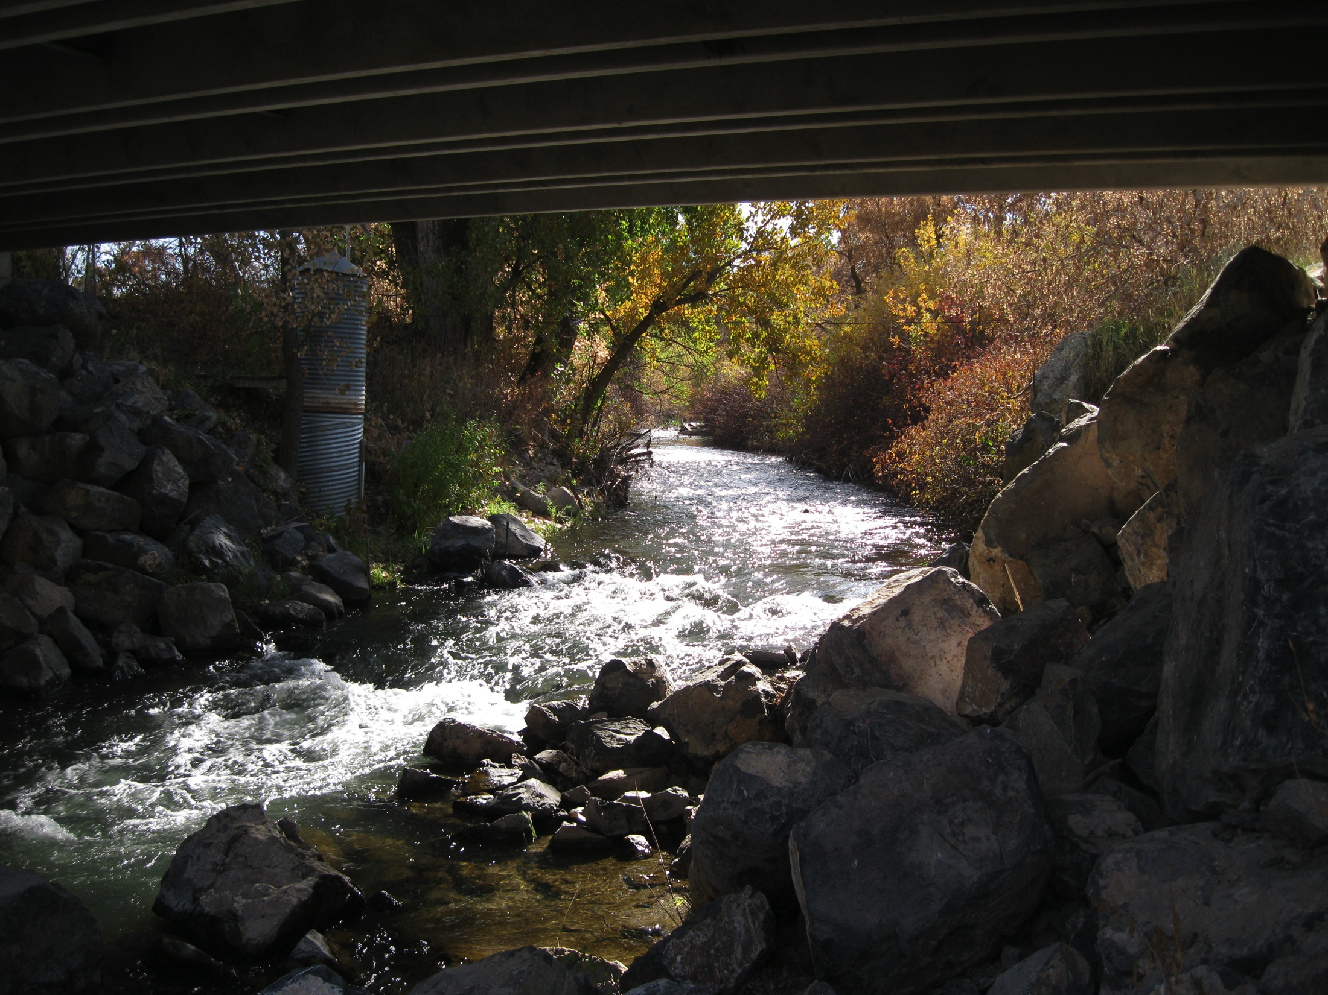


Questions?
amber.jones@usu.edu
http://data.iutahepscor.org/surveys
https://github.com/uchic/SurveyDataViewer/
Notes:
GITHUB

Slide 19
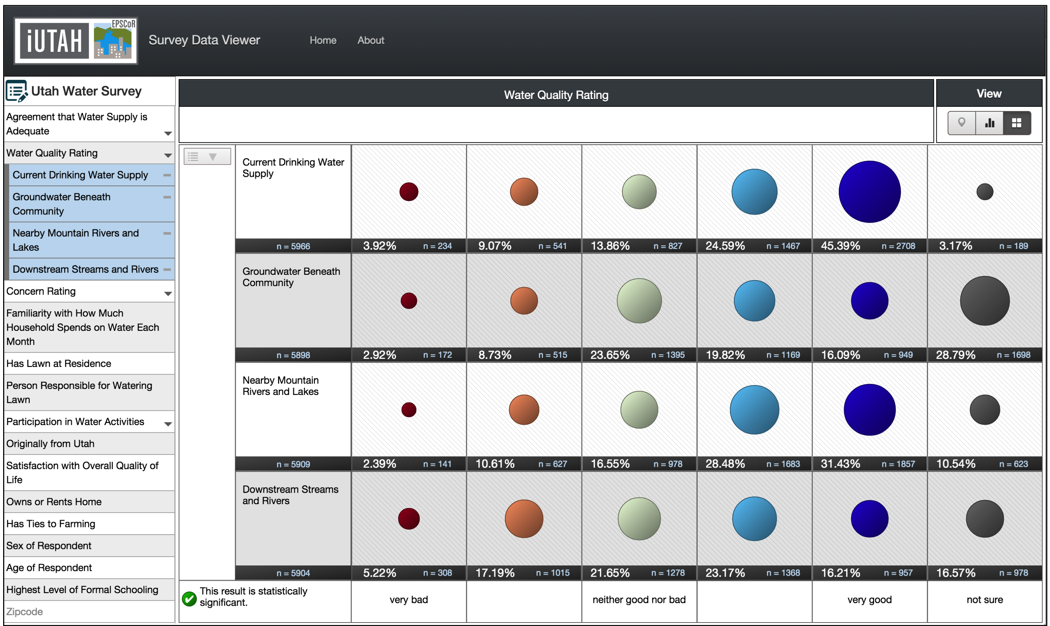
Case Study: Social Science Survey Data
Question type dictates color scheme
“Nested” questions with similar structure can be viewed simultaneously
Likert style questions- results span a scale
Notes:
The Viewer Supports different types of questions:
Likert style questions- results that span a scale
Question types: unidirectional, bidirectional, categorical
Supports ‘nested questions’ or questions with similar structure. These questions may be viewed simultaneously to compare responses.

Slide 20



Scales of Social Water Science Data
FEDERAL
Census Data
Hazard Event Data
Policies
STATE
Interviews & Surveys with Agency Staff & Policy Makers
Hazard Event Data
Policies & Documents
WATERSHED/REGION
Land Use & Amenity Data
News Articles
WATER DISTRICT
Interviews & Surveys with Providers
Websites & Documents
Interviews & Surveys with Key Informants
Water Use & Price Data
MUNICIPALITY
MUNICIPALITY
Websites & Documents
Interviews & Surveys with Households & Public
NEIGHBORHOOD
Park
NEIGHBORHOOD
Park
NEIGHBORHOOD
Park
NEIGHBORHOOD
Park
Store
Store
Store
Store
Notes:
We’ve been working to better understand the types of social water science data. One way we’ve done this is by examining at the scales.
In iUTAH, we are collecting and generating social science data at multiple scales of the water system- from individual, household, and neighborhood levels up to municipality, water district, watershed, state, and federal levels. The types of data that are collected may vary between scales.

Slide 21
Social Science Data
Water systems are increasingly conceptualized as coupled human-natural systems.
Social science: the study of “the social life of human beings” [Hunt and Colander, 2016], including patterns of human organization and behavior.
Need to expand range of data types in hydrology.
Social science data may be unfamiliar or intimidating.
Nuances in datasets are well known to social scientists, less understood by hydrologists and physical scientists.
Notes:
Increased recognition that social science must be incorporated into studies of the natural systems- hence ‘socio-hydrology’.
I’m not a social scientist, I’m an engineer and a data manager, so I’m concerned about how we handle, support, and integrate data collected as part of socio-hydrology studies.
We started working with social scientists and data types that we as data management team thought that we could better support and better provide access to.
Needed to raise the bar of understanding for social scientists and hydrologists working together to understand the types of data and the implications for data access, visualization and management.

